Slide 1
Convert .pep.xml data to .tsv
FDR thresholding
m/z recalibration
Filtering: phosphorylated PSMs only
Non-strict peptidoform ID assignment
To do: include number of peptidoforms remaining at each step and arrange in a nicer way; show mini figure snapshots to illustrate analyses; this is a methods fig.
Data aggregated by peptidoform ID
Filtering:
90+ PSMs
AND
3+ experiments
GMM model fitting and selection
AUC calculation and thresholding: peptidoforms assigned to m/z bins
Bin enrichment analyses:
Chi squared (e.g. # instrument contributions by bin)
GO enrichment (small numbers of proteins)
KEGG pathways (nothing really stands out but should report)
Custom term mapping and enrichment (known_sY, secreted, transmembrane, Golgi)
Peptide amino acid sequence
PTM1_count
PTM3_count
nEQSPPPPLQTSSGAEVMDVGSGGDGQSELPAEDPFNFYGASLLSK_M147_1_n230_1_S167_1
PTM2_count
non-strict ID = PTM position does not matter (e.g. any S could be pS)
nEQSPPPPLQTSSGAEVMDVGSGGDGQSELPAEDPFNFYGASLLSK_n230_1_S167_1
NB: The same peptide can have multiple peptidoforms IDs based on PTM combinations present
Fig. 1. Workflow

Slide 2
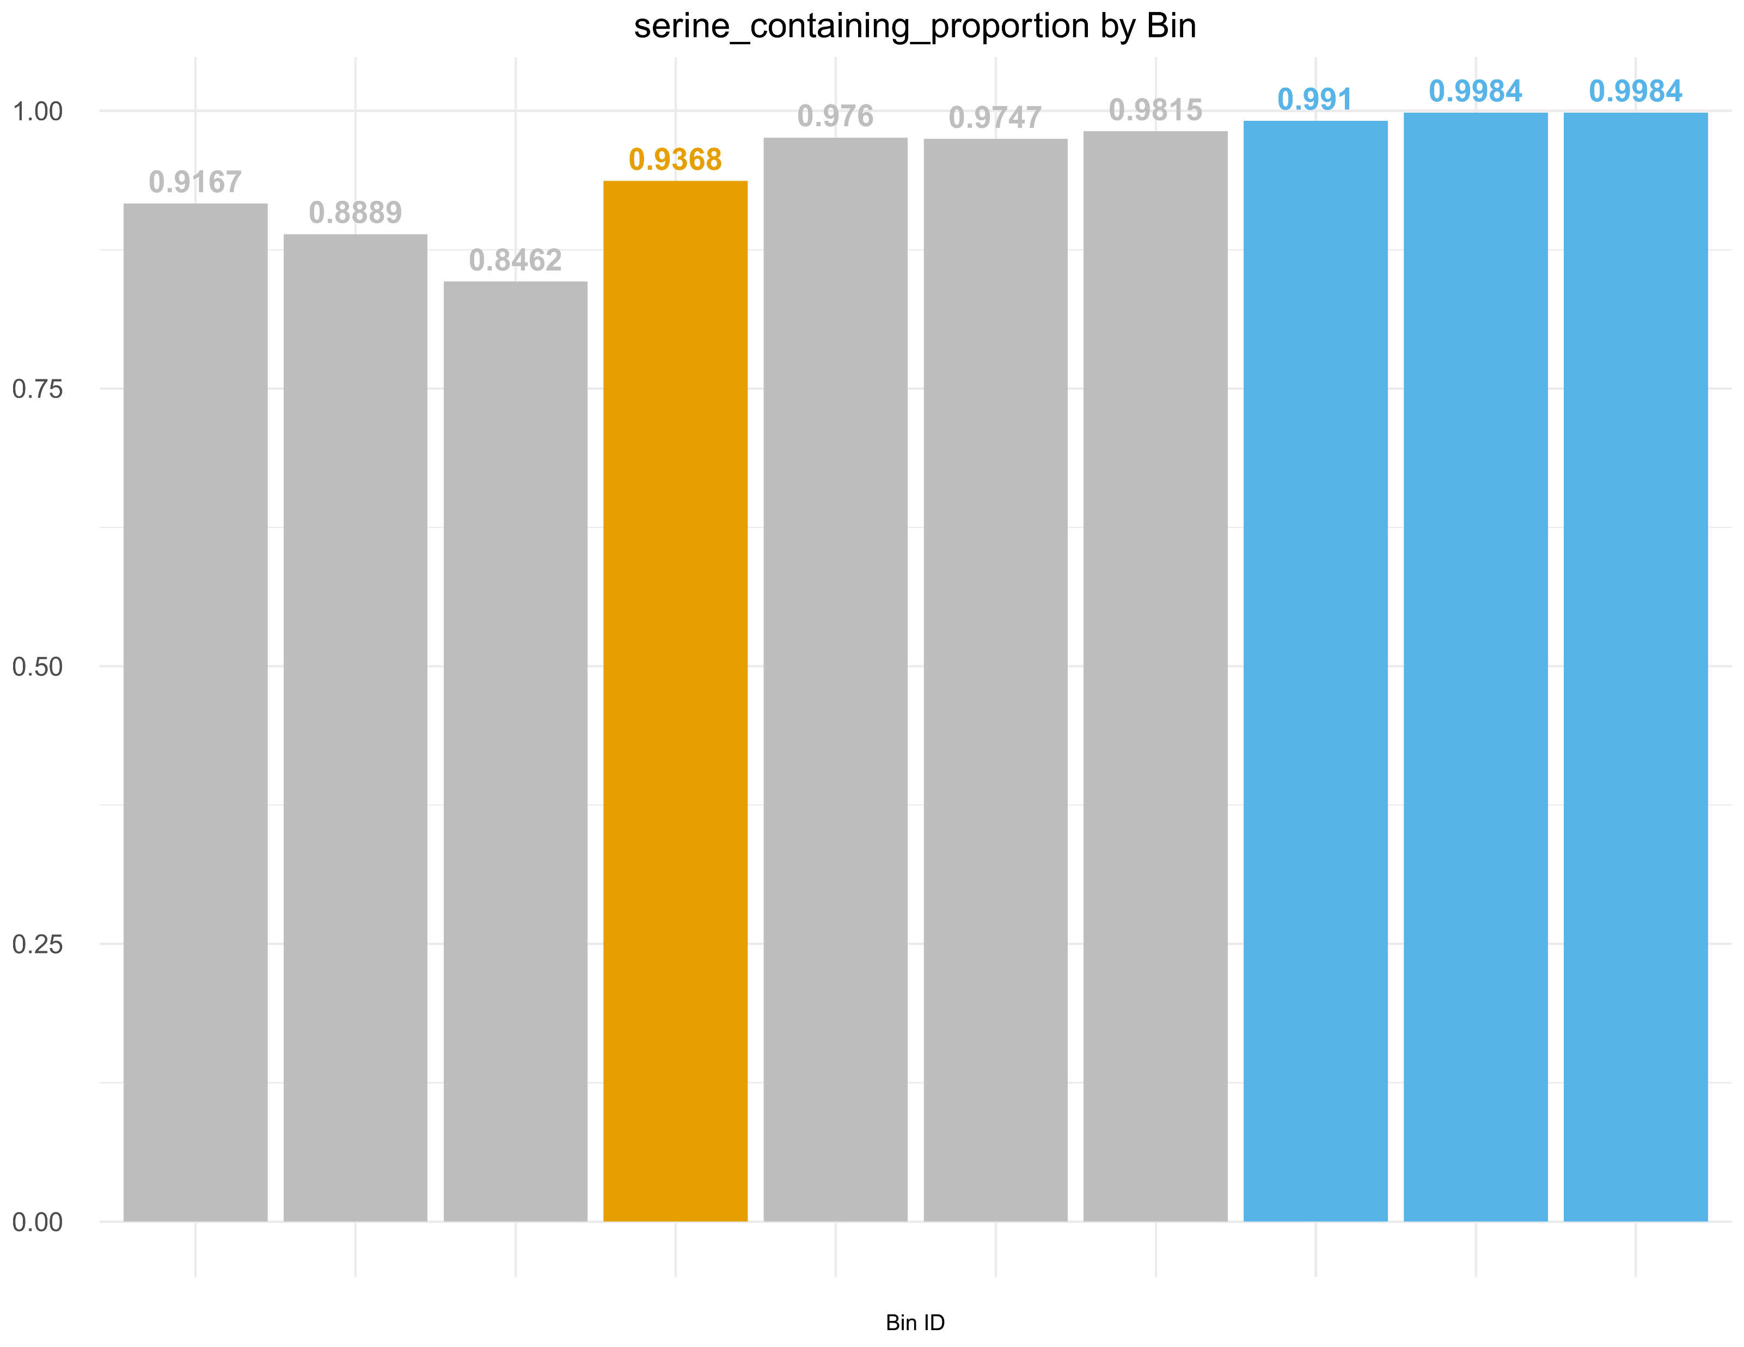
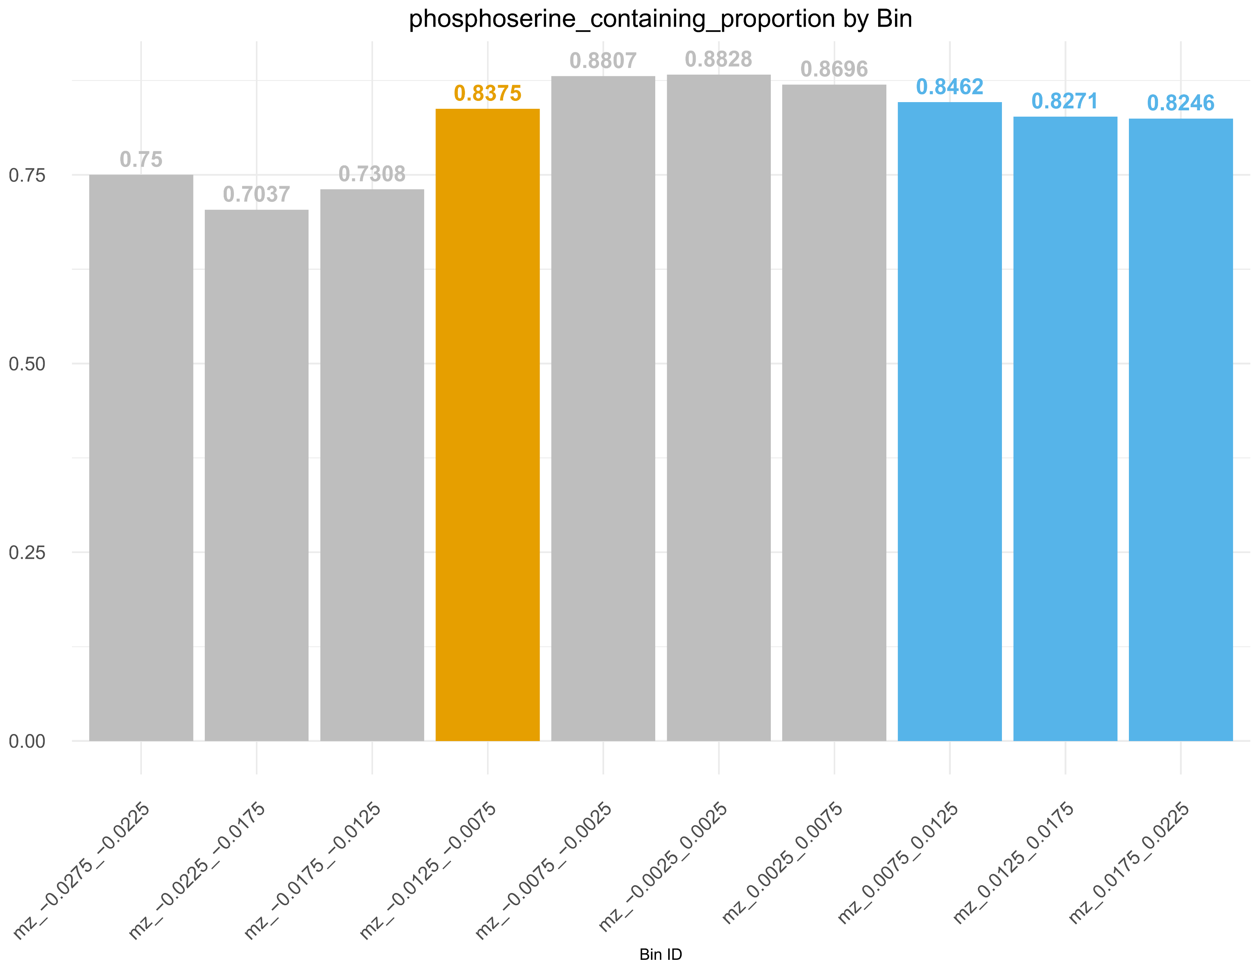
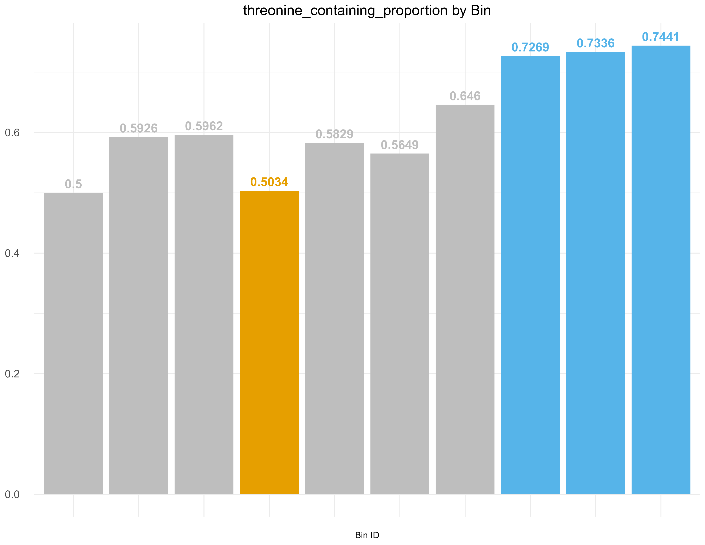
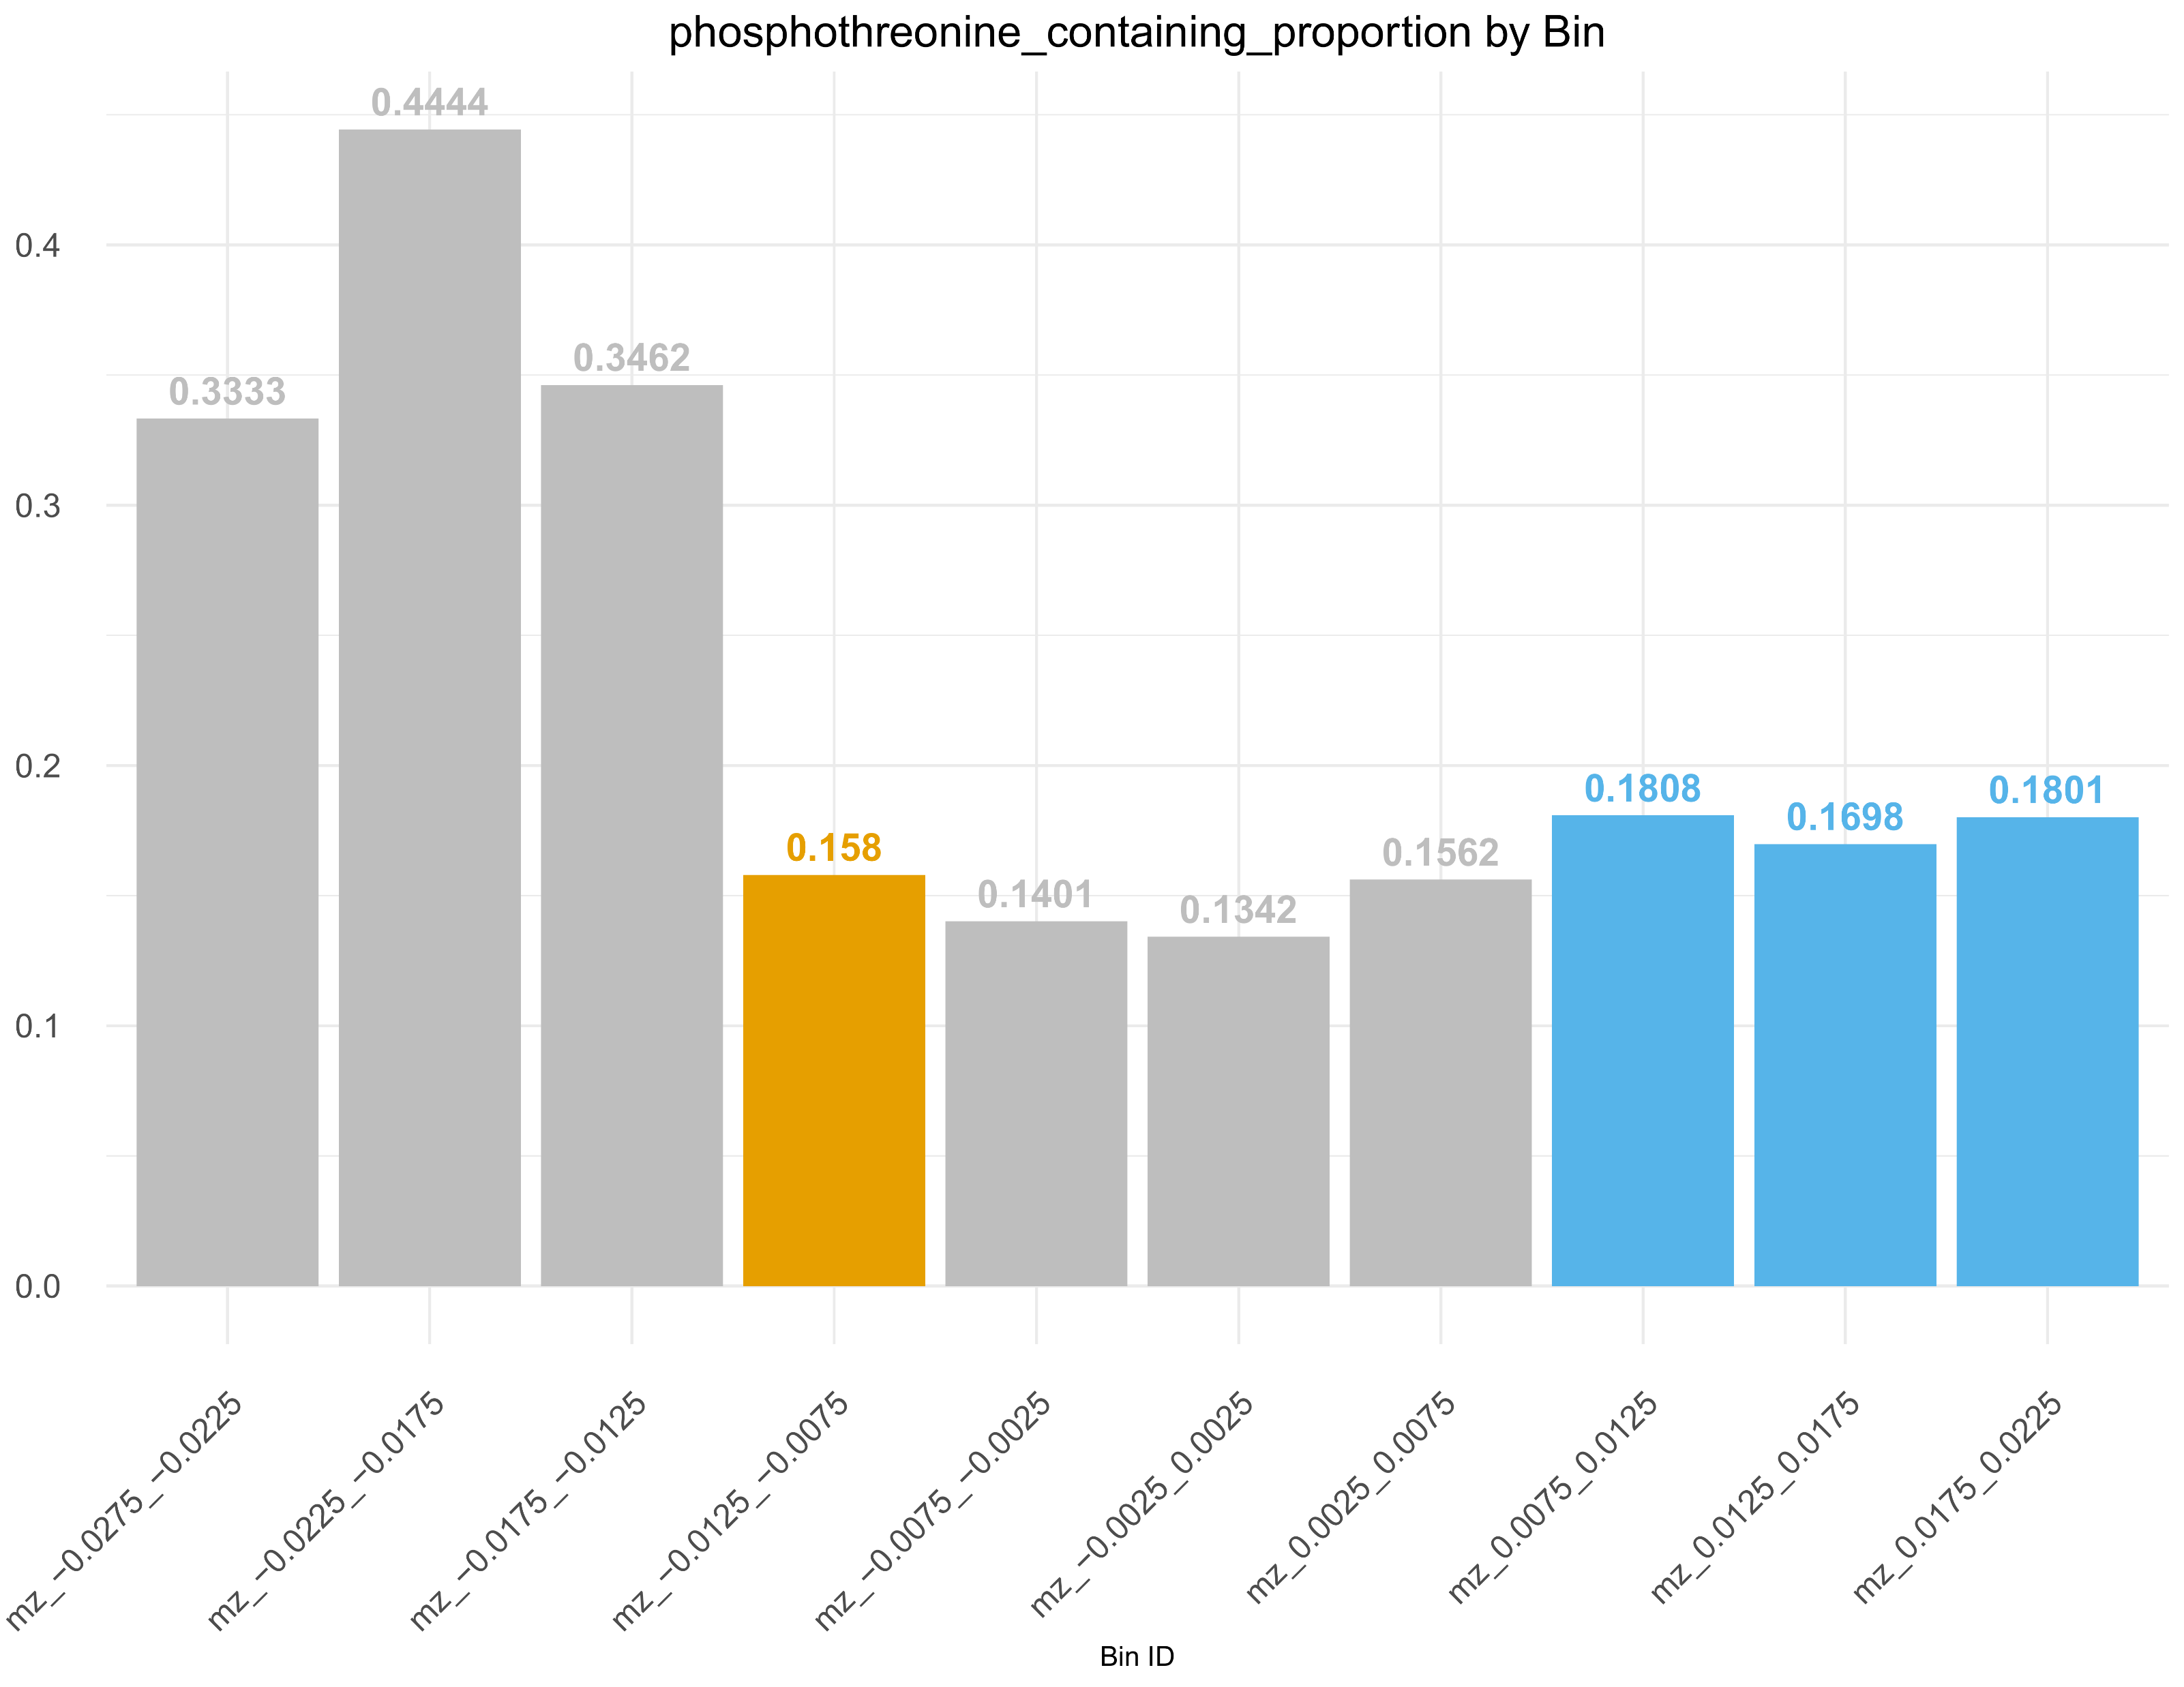
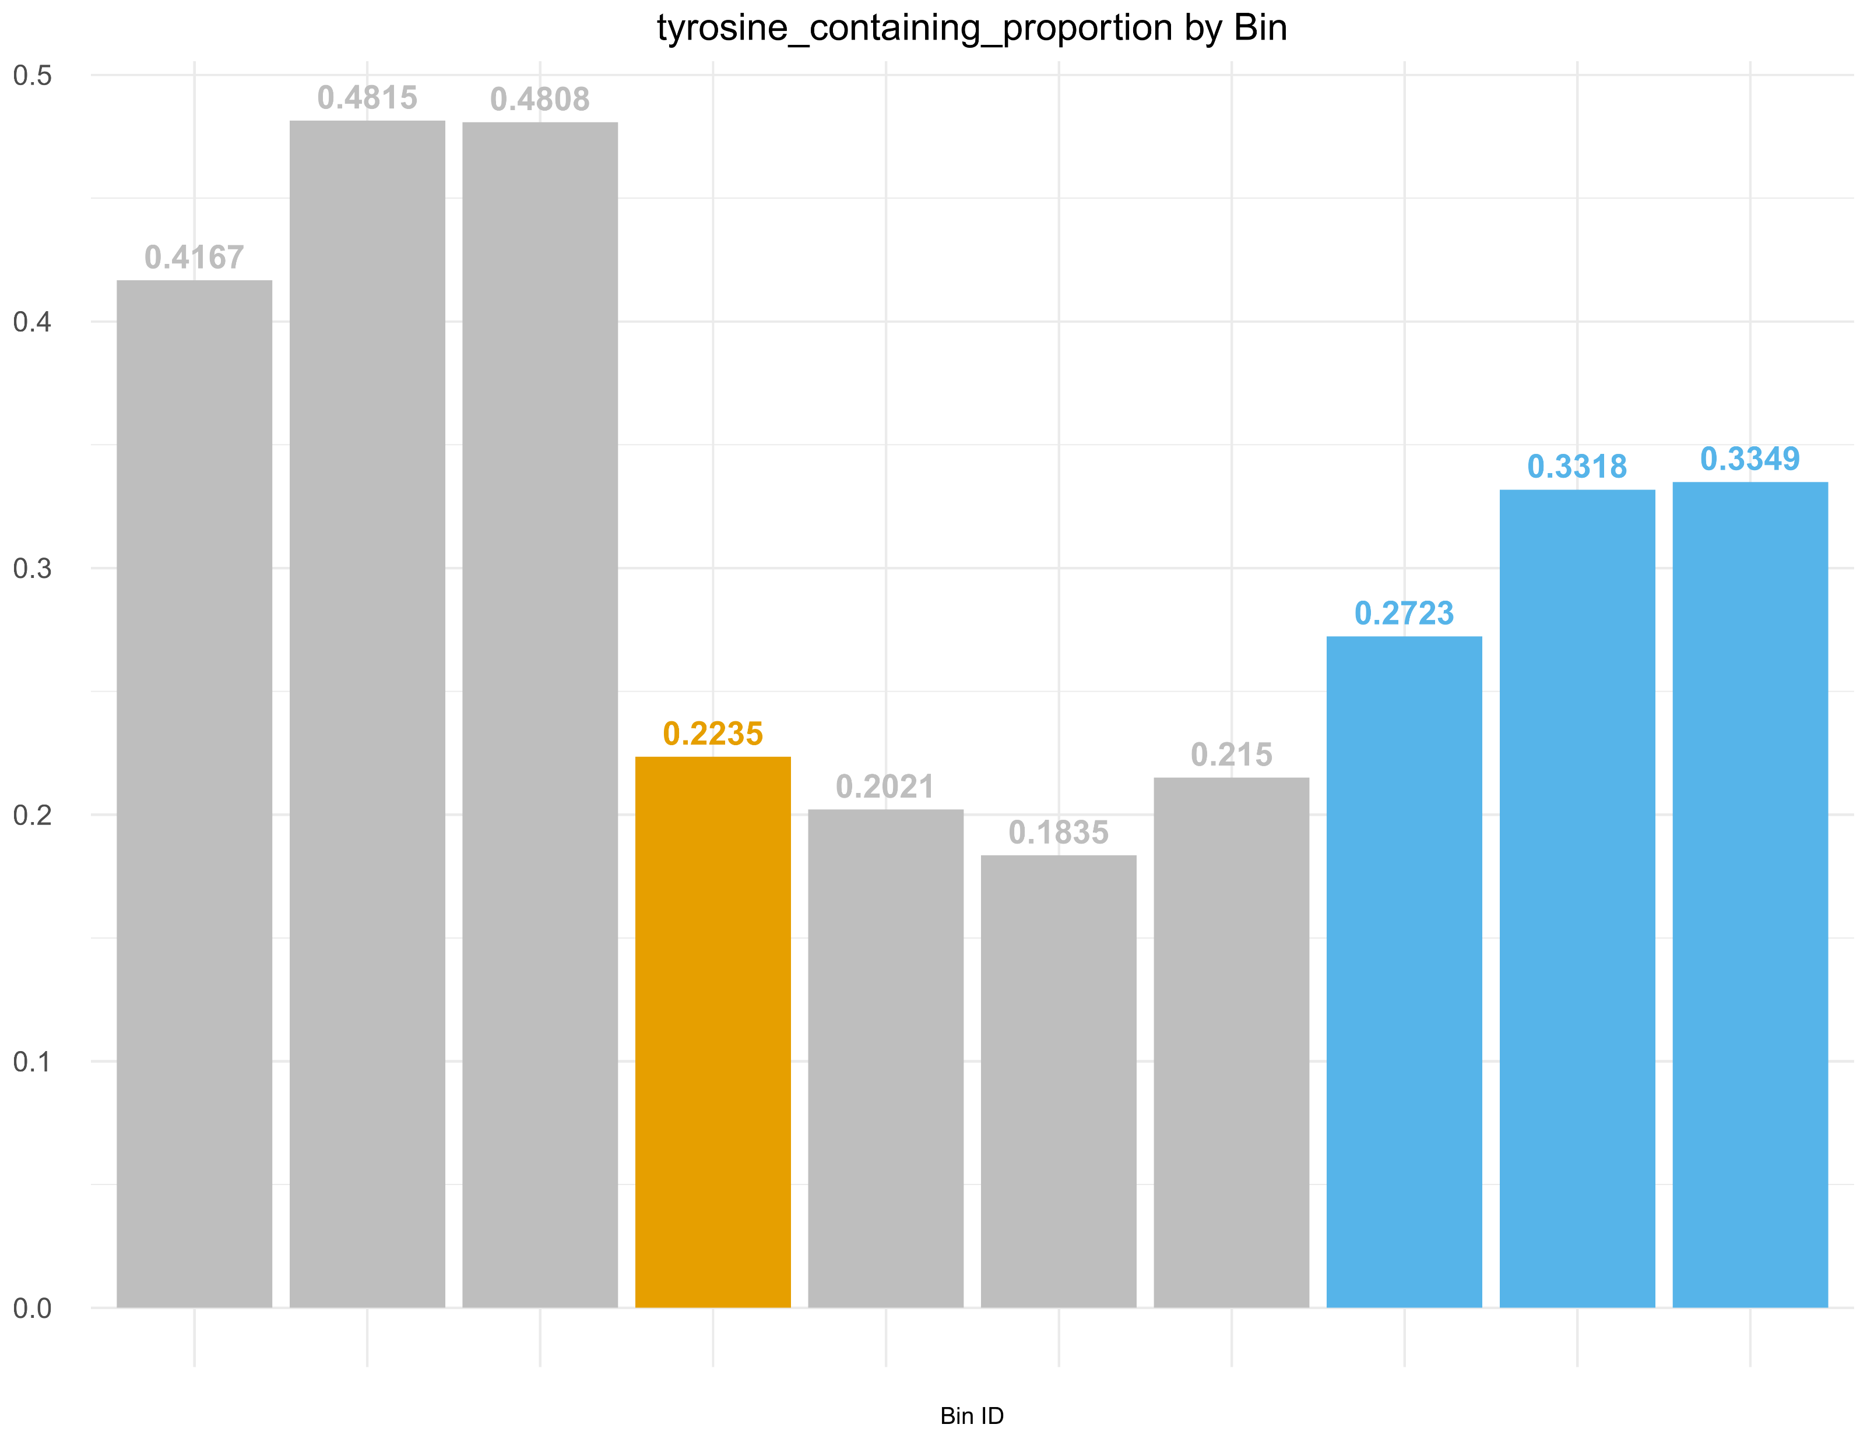
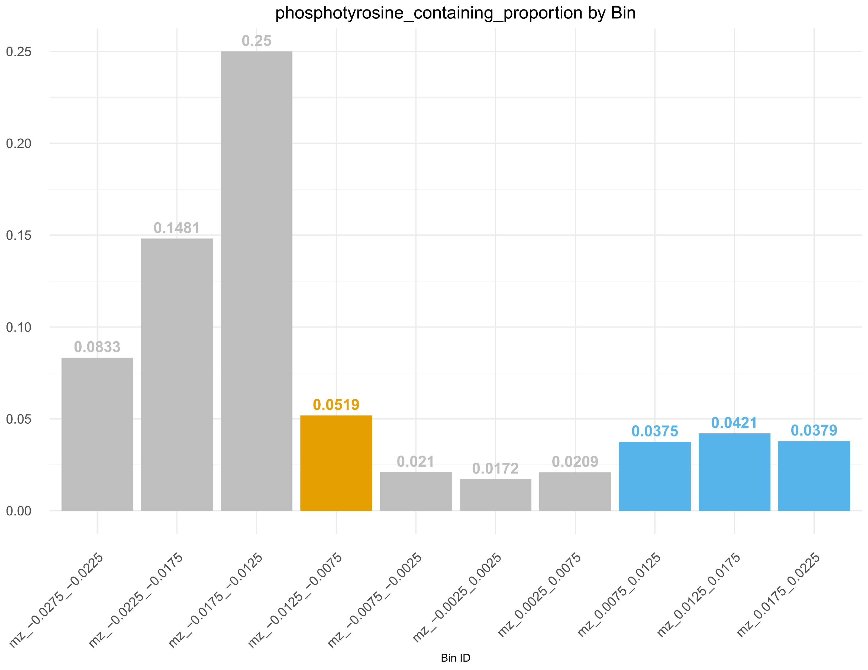
A
B
Mention total numbers in legend or as table
Regenerate plots with x axis scale ticks?
D
E
F
Notes:
What do we think about all these other peptidoforms that are sneaking through that do not contain Y – by random chance it will be more likely in the bin of interest that this is by chance than in the bins to the left;
Seems interesting we see more T and pT in these bins; could be by chance since small numbers but perhaps a Venn diagram showing how many of the T containing also have a Y and could be mis-assigned pT instead of pY might be nice here?
Do the last plots (fraction of T-containing assigned pT and fraction of Y-containing assigned pY need to be part of the fig? – not really, looks like we’re doing some gymnastics, better leave other row

Slide 3
Ribosomal protein S6 kinase alpha-3; False positive peptidoform example
Sulfotransferase 2A1,
Sulfated only example; 1 peptidoform
Vitronectin, known sY protein:
Doubly and singly sulfated peptide; total of 10 peptidoforms of Vitronectin found in BOI and bin -1; 2 peptides (and incl shortened versions of 1)
Osteopontin – secreted;
Mostly sulfo, some phospho PSMs
5 peptidoforms derived from 2 peptides
Fig. 2. Example Histograms – my idea was to have an example of:
doubly sulfated.
Singly sulfated,
mix sulfated /phosphorylated,
False positives
To Decide: Also potentially add example of Calumenin, 6 peptidoforms – at least worth a mention in the text – no real link in literature so it might be a novel true sulfo?
Put in
To do: tidy up once we decide

Slide 4
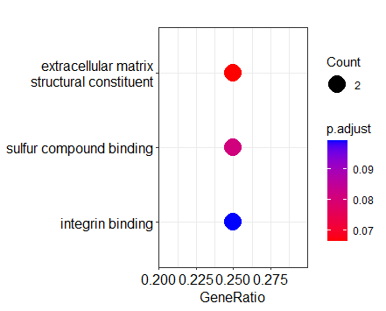
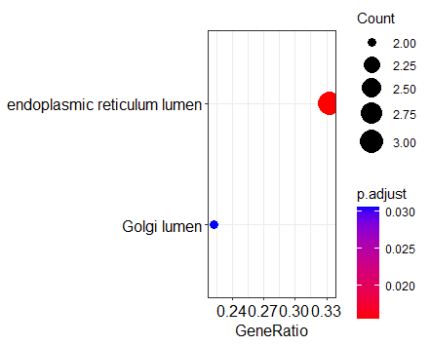
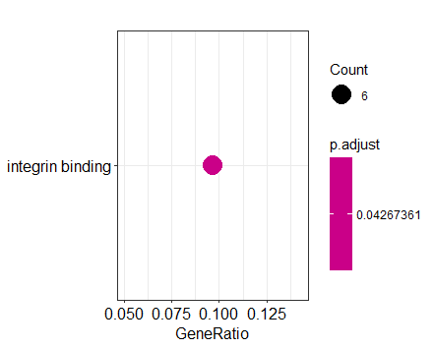
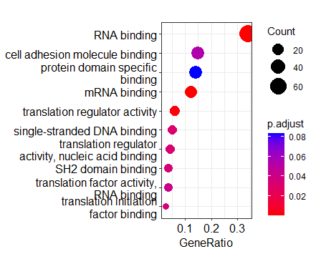
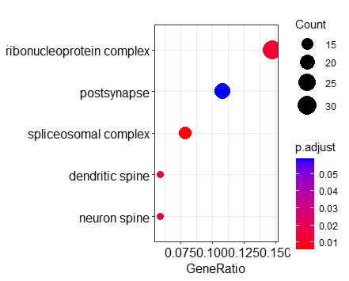
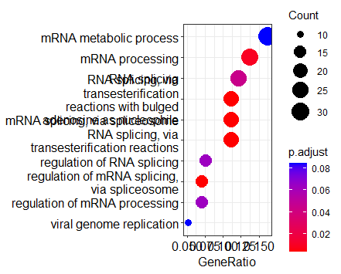
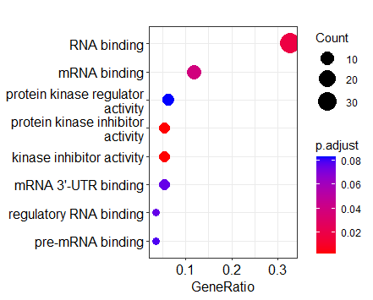
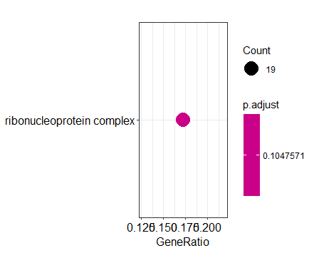
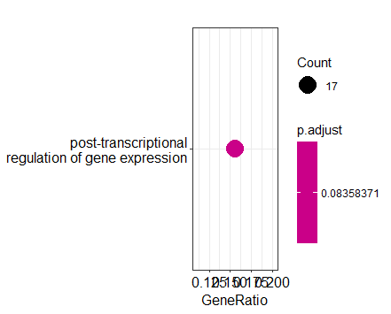
MF
CC
BP
No hits
with q <= 0.1
Bin_minus1
No hits
with q <= 0.1
No hits
with q <= 0.1
BOI
DECOY1
No hits
with q <= 0.1
No hits
with q <= 0.1
No hits
with q <= 0.1
DECOY2
DECOY3
Conclude from here that custom terms may be more suitable as sY is not strictly associated with any particular BP/MF/CC?
NOTES – TO READ/DISCUSS
Notes:
NEED HELP MAKING CHOICE HERE – better way to visualise these?
Cytokines known to be sulfated -
TODO: change plot margins individually so all terms fit; do we even want to do q 0.1 just to show some of the close to significant hits?
I think these are interesting to show for the DECOY bins especially since we have large enough counts in the significant terms. This can tie in with later on results showing specific instruments seem to contribute to these bins more – next thing to consider here is if it is the instrument or the specific tissue/conditions studied and if it’s more prone to changes in these significant processes/functions?
OR is there some other bias in the enrichment terms themselves and the current ways in which we do such analyses?

Slide 5
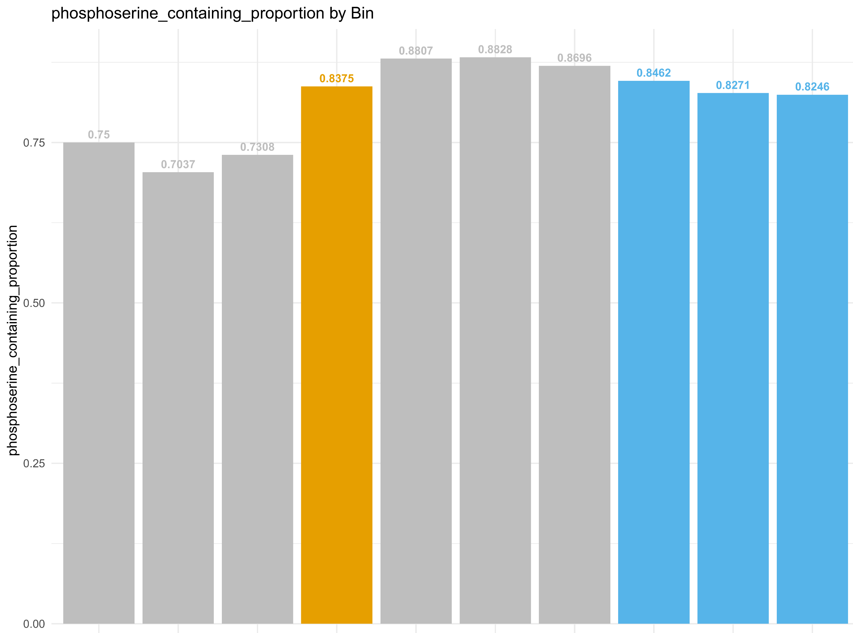
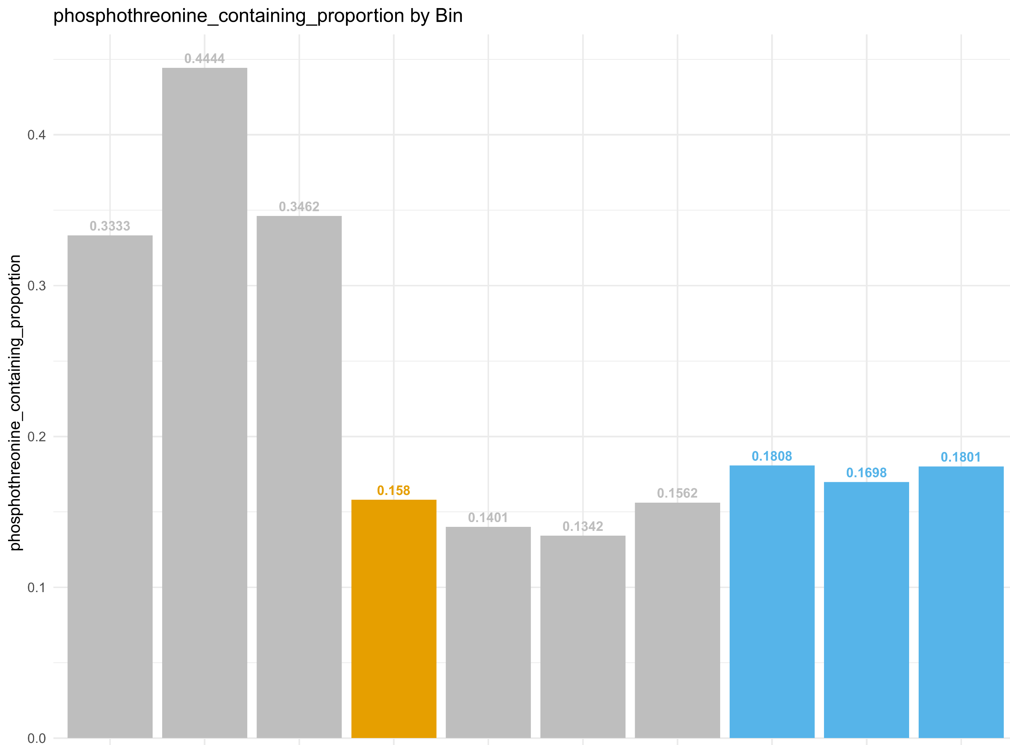
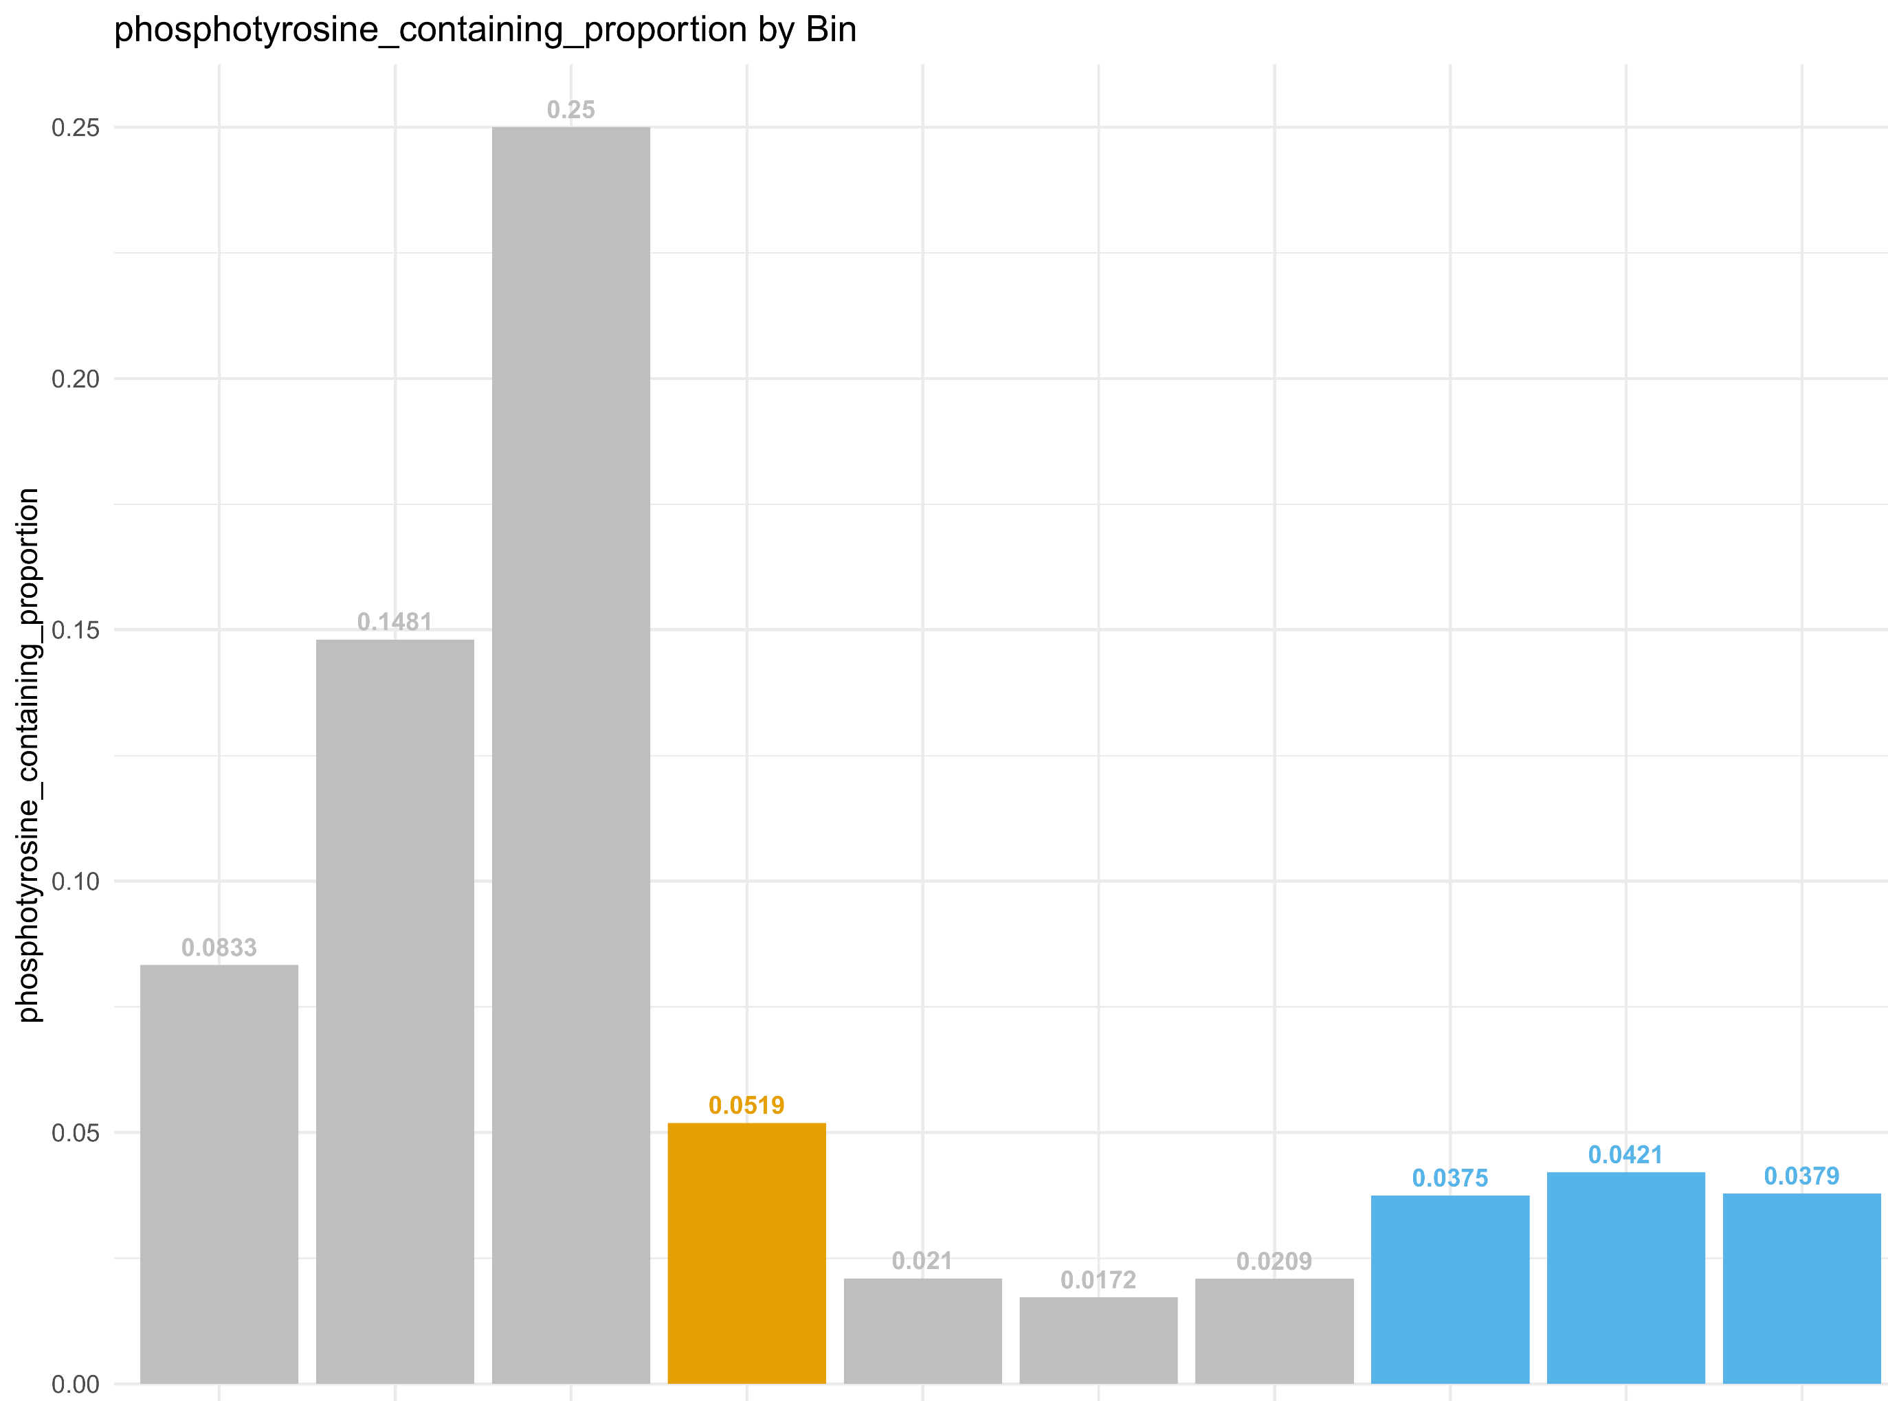
A
B
C
D
E
F
-0.0225
-0.0175
-0.0125
-0.0075
-0.0025
0.0025
0.0075
0.0125
0.0175
-0.0225
-0.0175
-0.0125
-0.0075
-0.0025
0.0025
0.0075
0.0125
0.0175
-0.0225
-0.0175
-0.0125
-0.0075
-0.0025
0.0025
0.0075
0.0125
0.0175
m/z
m/z
m/z
Fig. 2. Peptidoform distributions by bin
Mention total numbers in legend or as table
Regenerate plots with x axis scale ticks?
Notes:
What do we think about all these other peptidoforms that are sneaking through that do not contain Y – by random chance it will be more likely in the bin of interest that this is by chance than in the bins to the left;
Seems interesting we see more T and pT in these bins; could be by chance since small numbers but perhaps a Venn diagram showing how many of the T containing also have a Y and could be mis-assigned pT instead of pY might be nice here?
Do the last plots (fraction of T-containing assigned pT and fraction of Y-containing assigned pY need to be part of the fig? – not really, looks like we’re doing some gymnastics, better leave other row

Slide 6
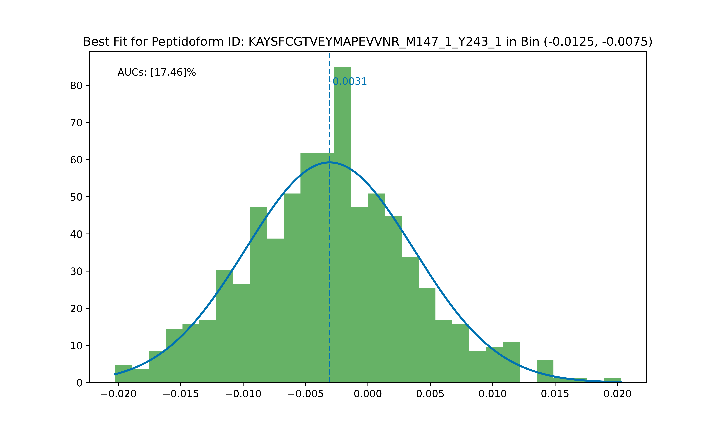
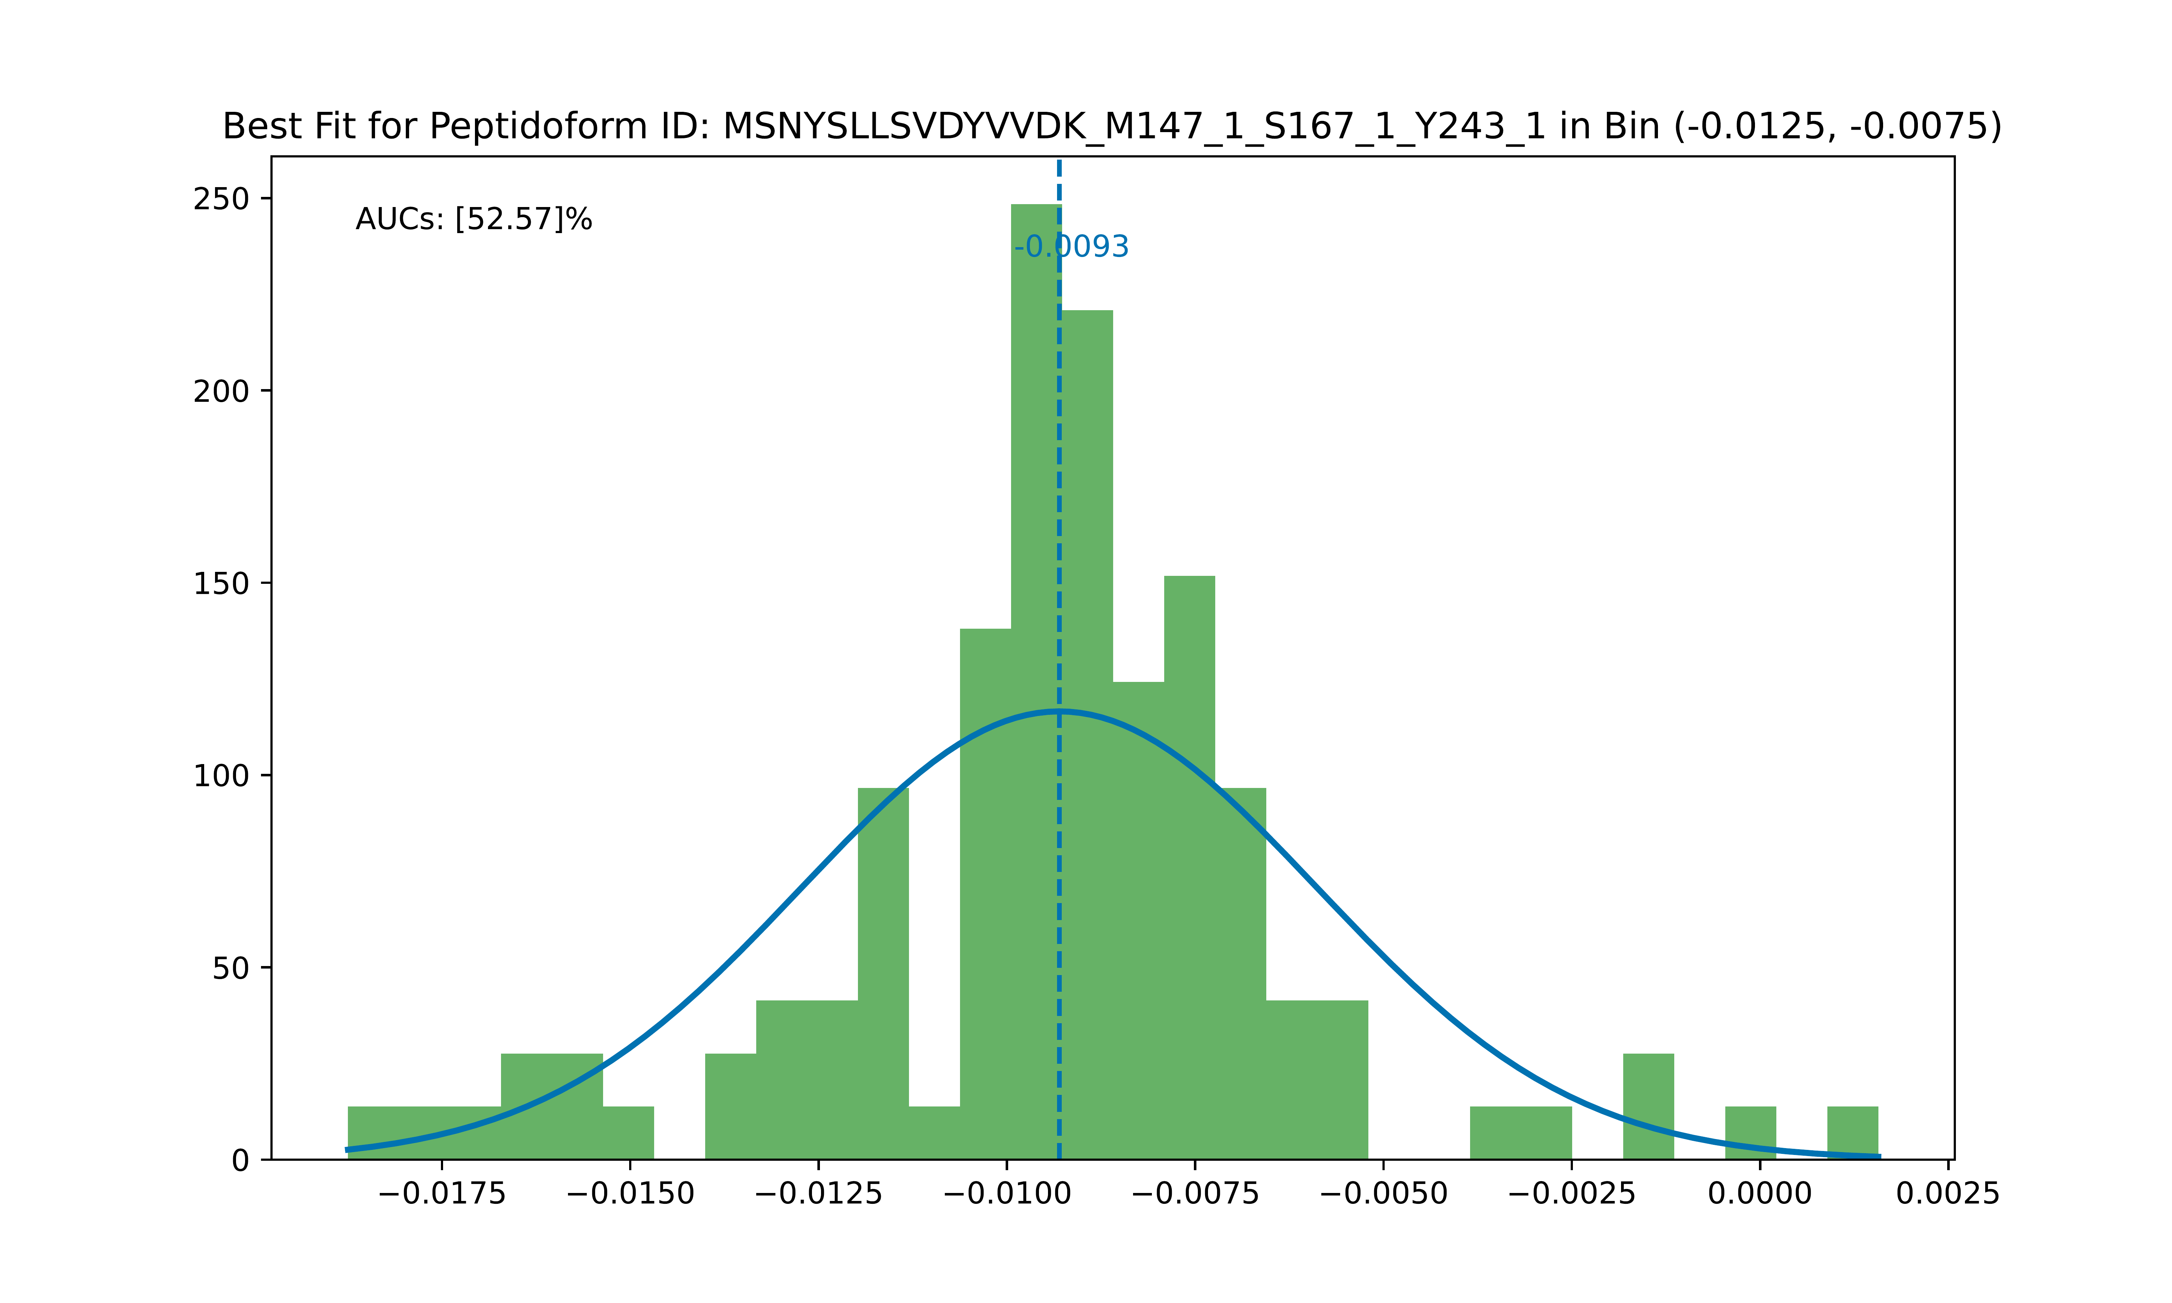
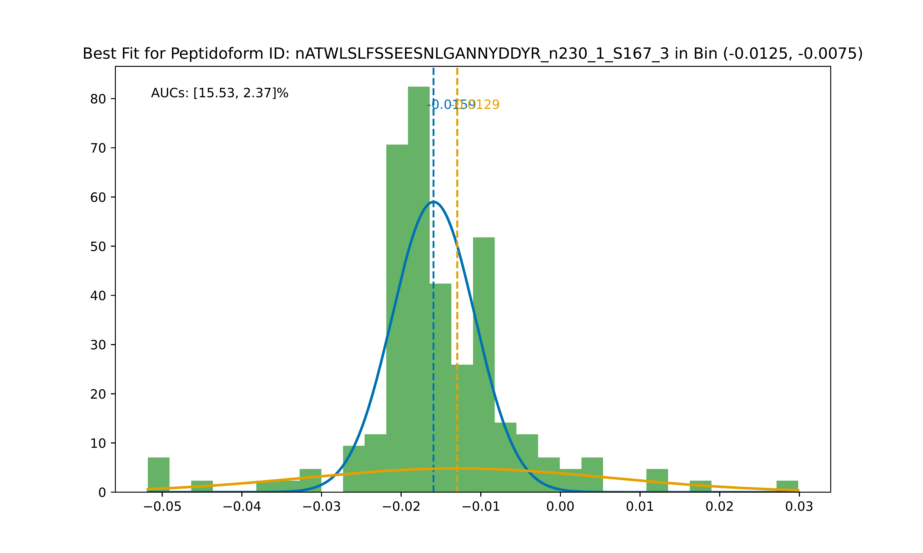
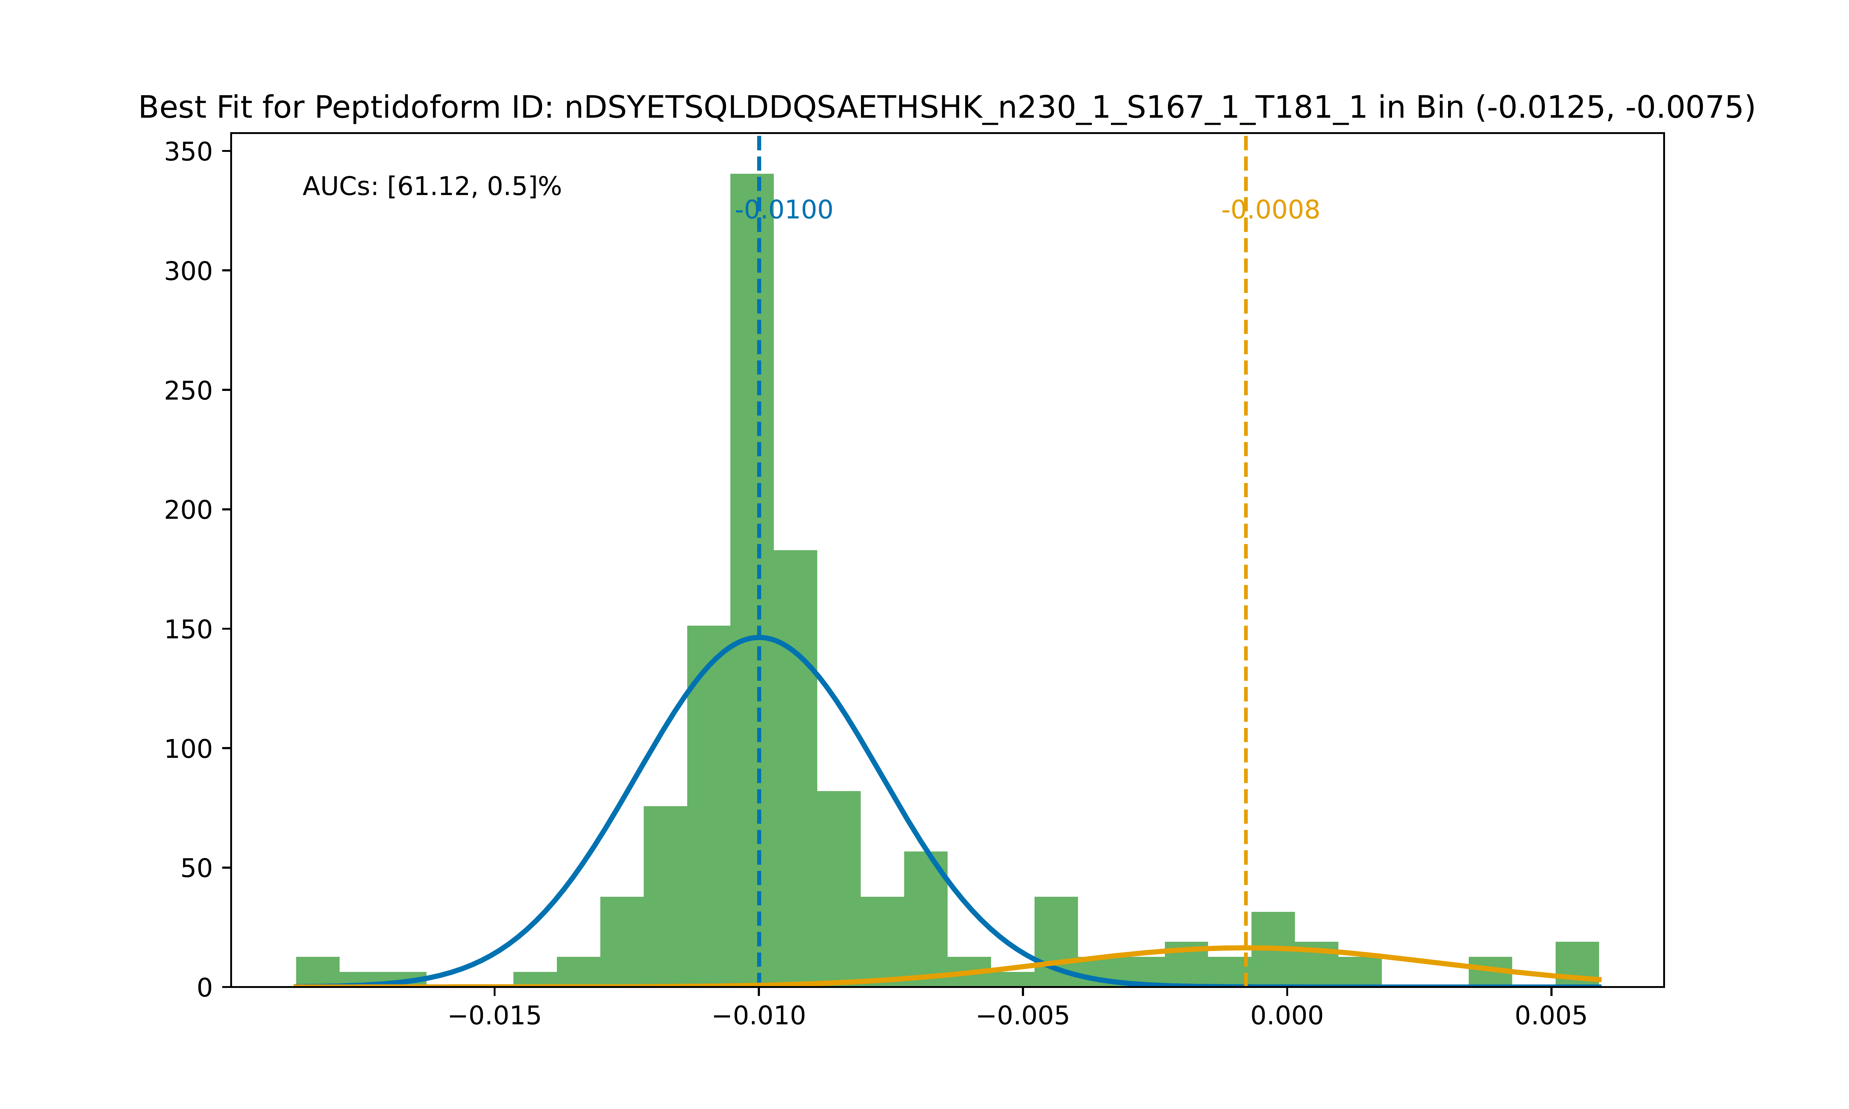
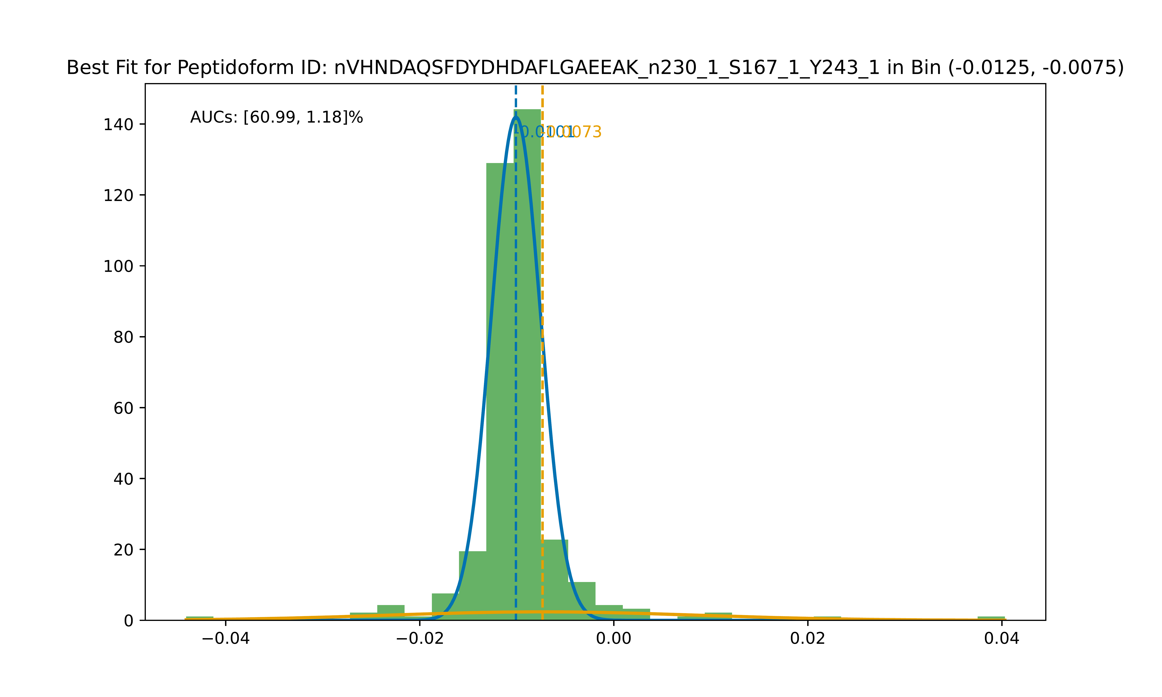
A
B
C
D
E
Fig. 2. Example histograms of peptidoforms with AUC > 15% in BOI
A) Ribosomal protein S6 kinase alpha-3; False positive peptidoform example
B) Sulfotransferase 2A1, Sulfated only example; 1 peptidoform for this protein; potential novel info
on sulfation
C) Vitronectin, known sY protein: Doubly or singly sulfated peptide; total of 10 peptidoforms of Vitronectin found in BOI and bin -1; 2 peptides (and incl shortened versions of 1), both of which contain known sY residues
D) Osteopontin – secreted; Mostly sulfo, some phospho PSMs; 5 peptidoforms derived from 2 peptides; potential novel sulfation
E) Calumenin – potential novel sulfation

Slide 7
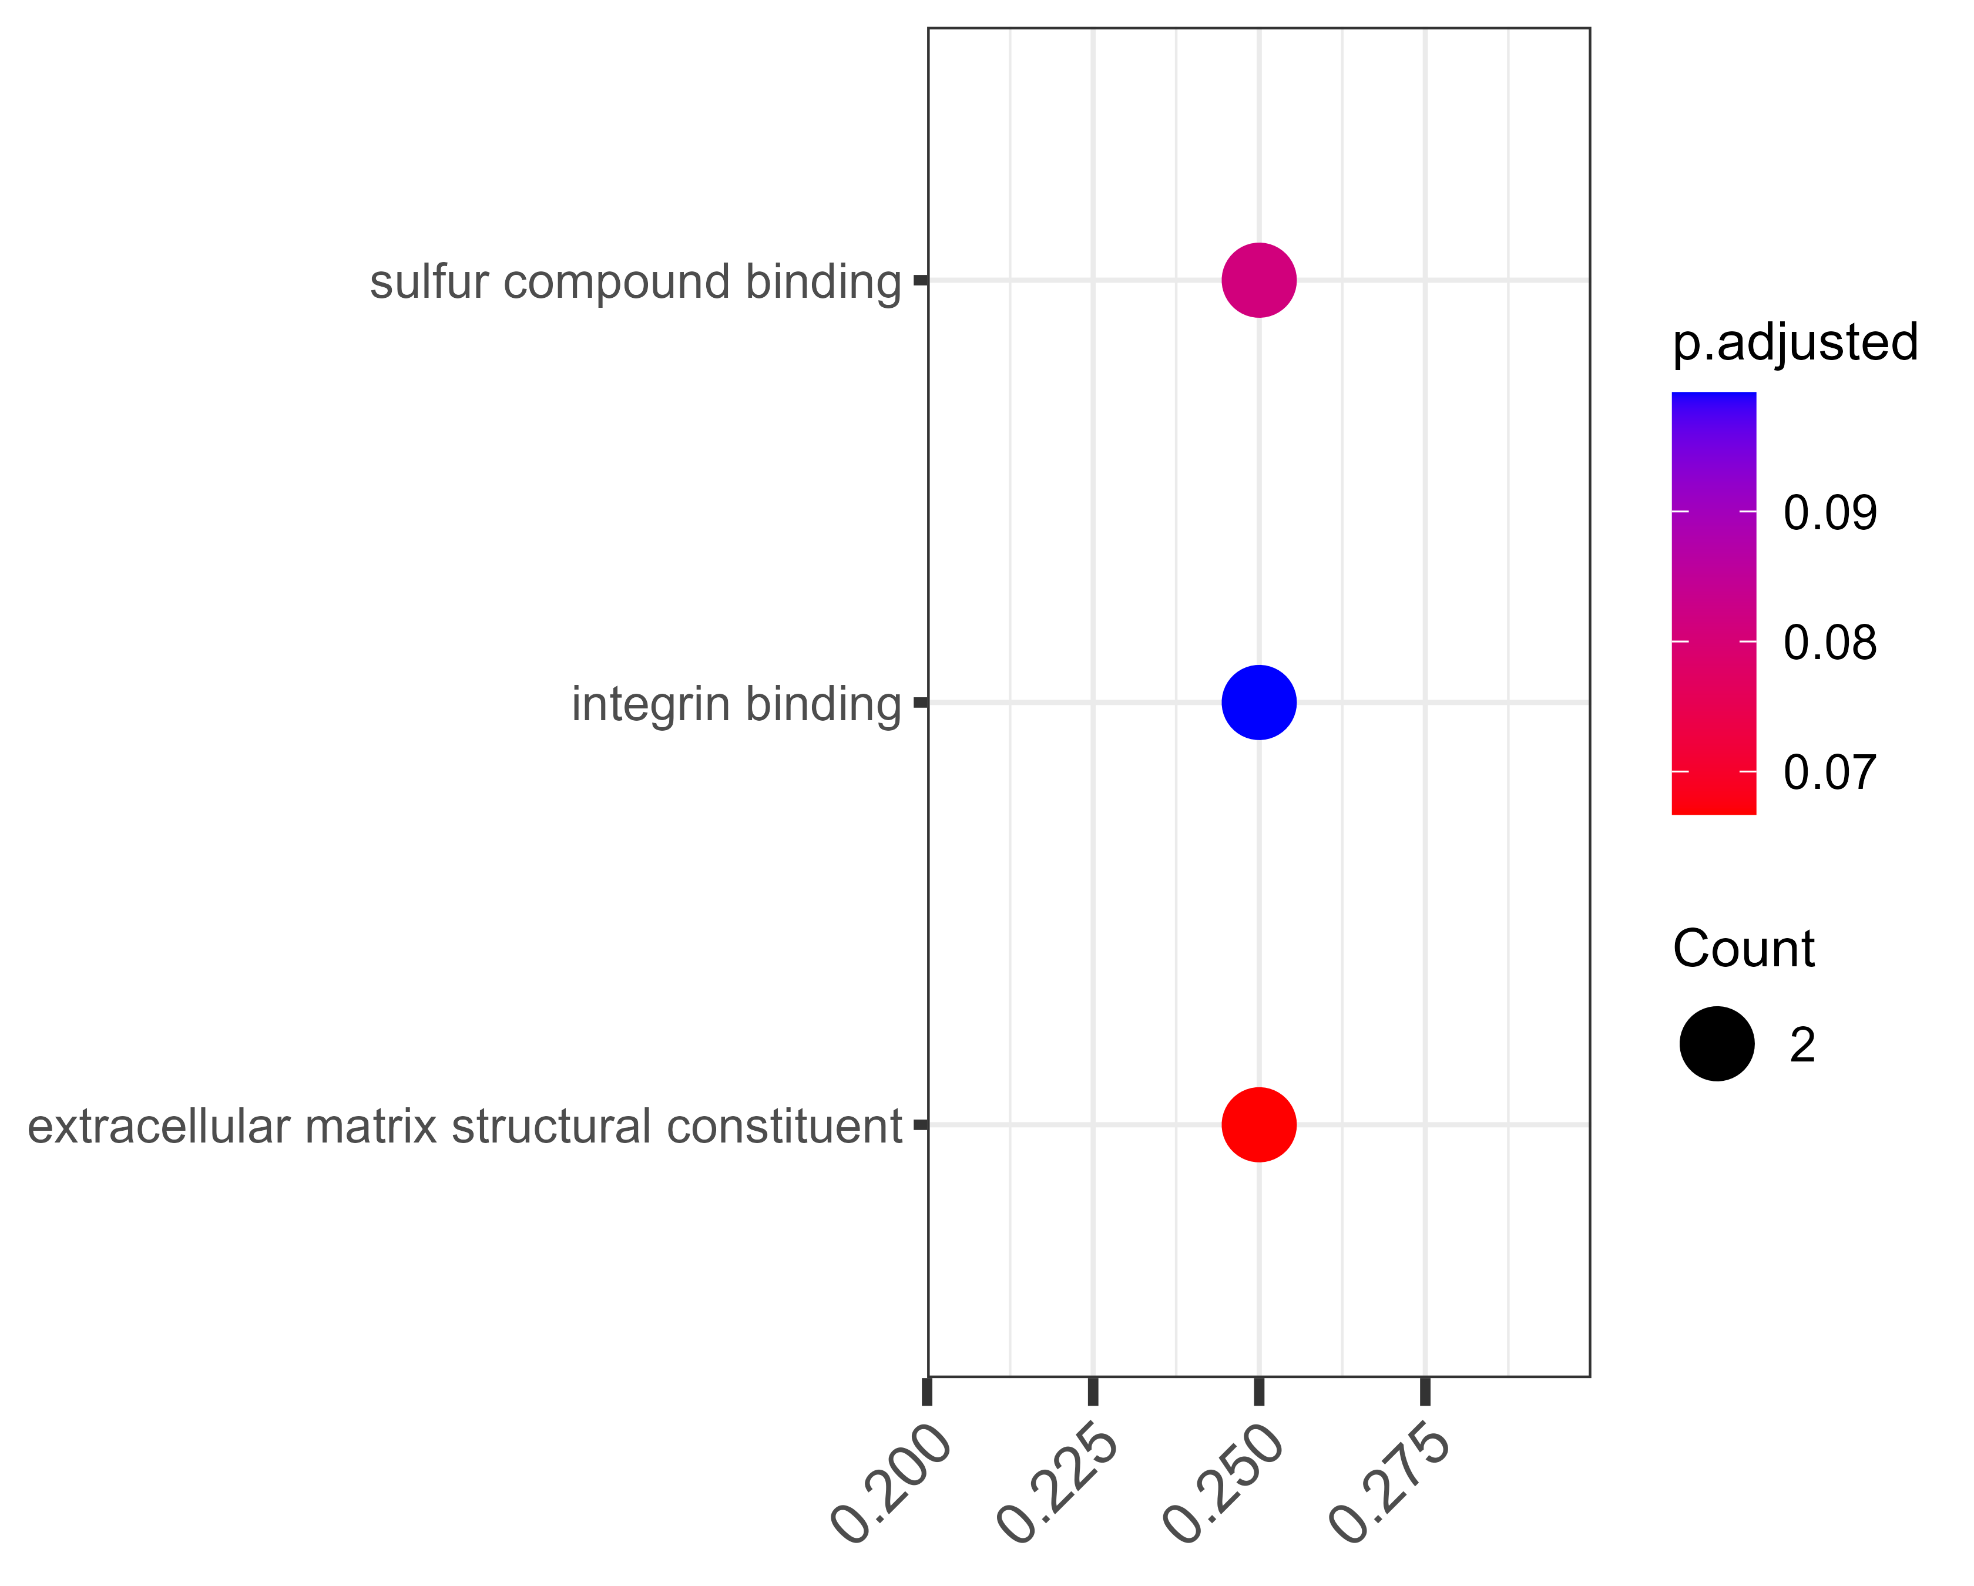
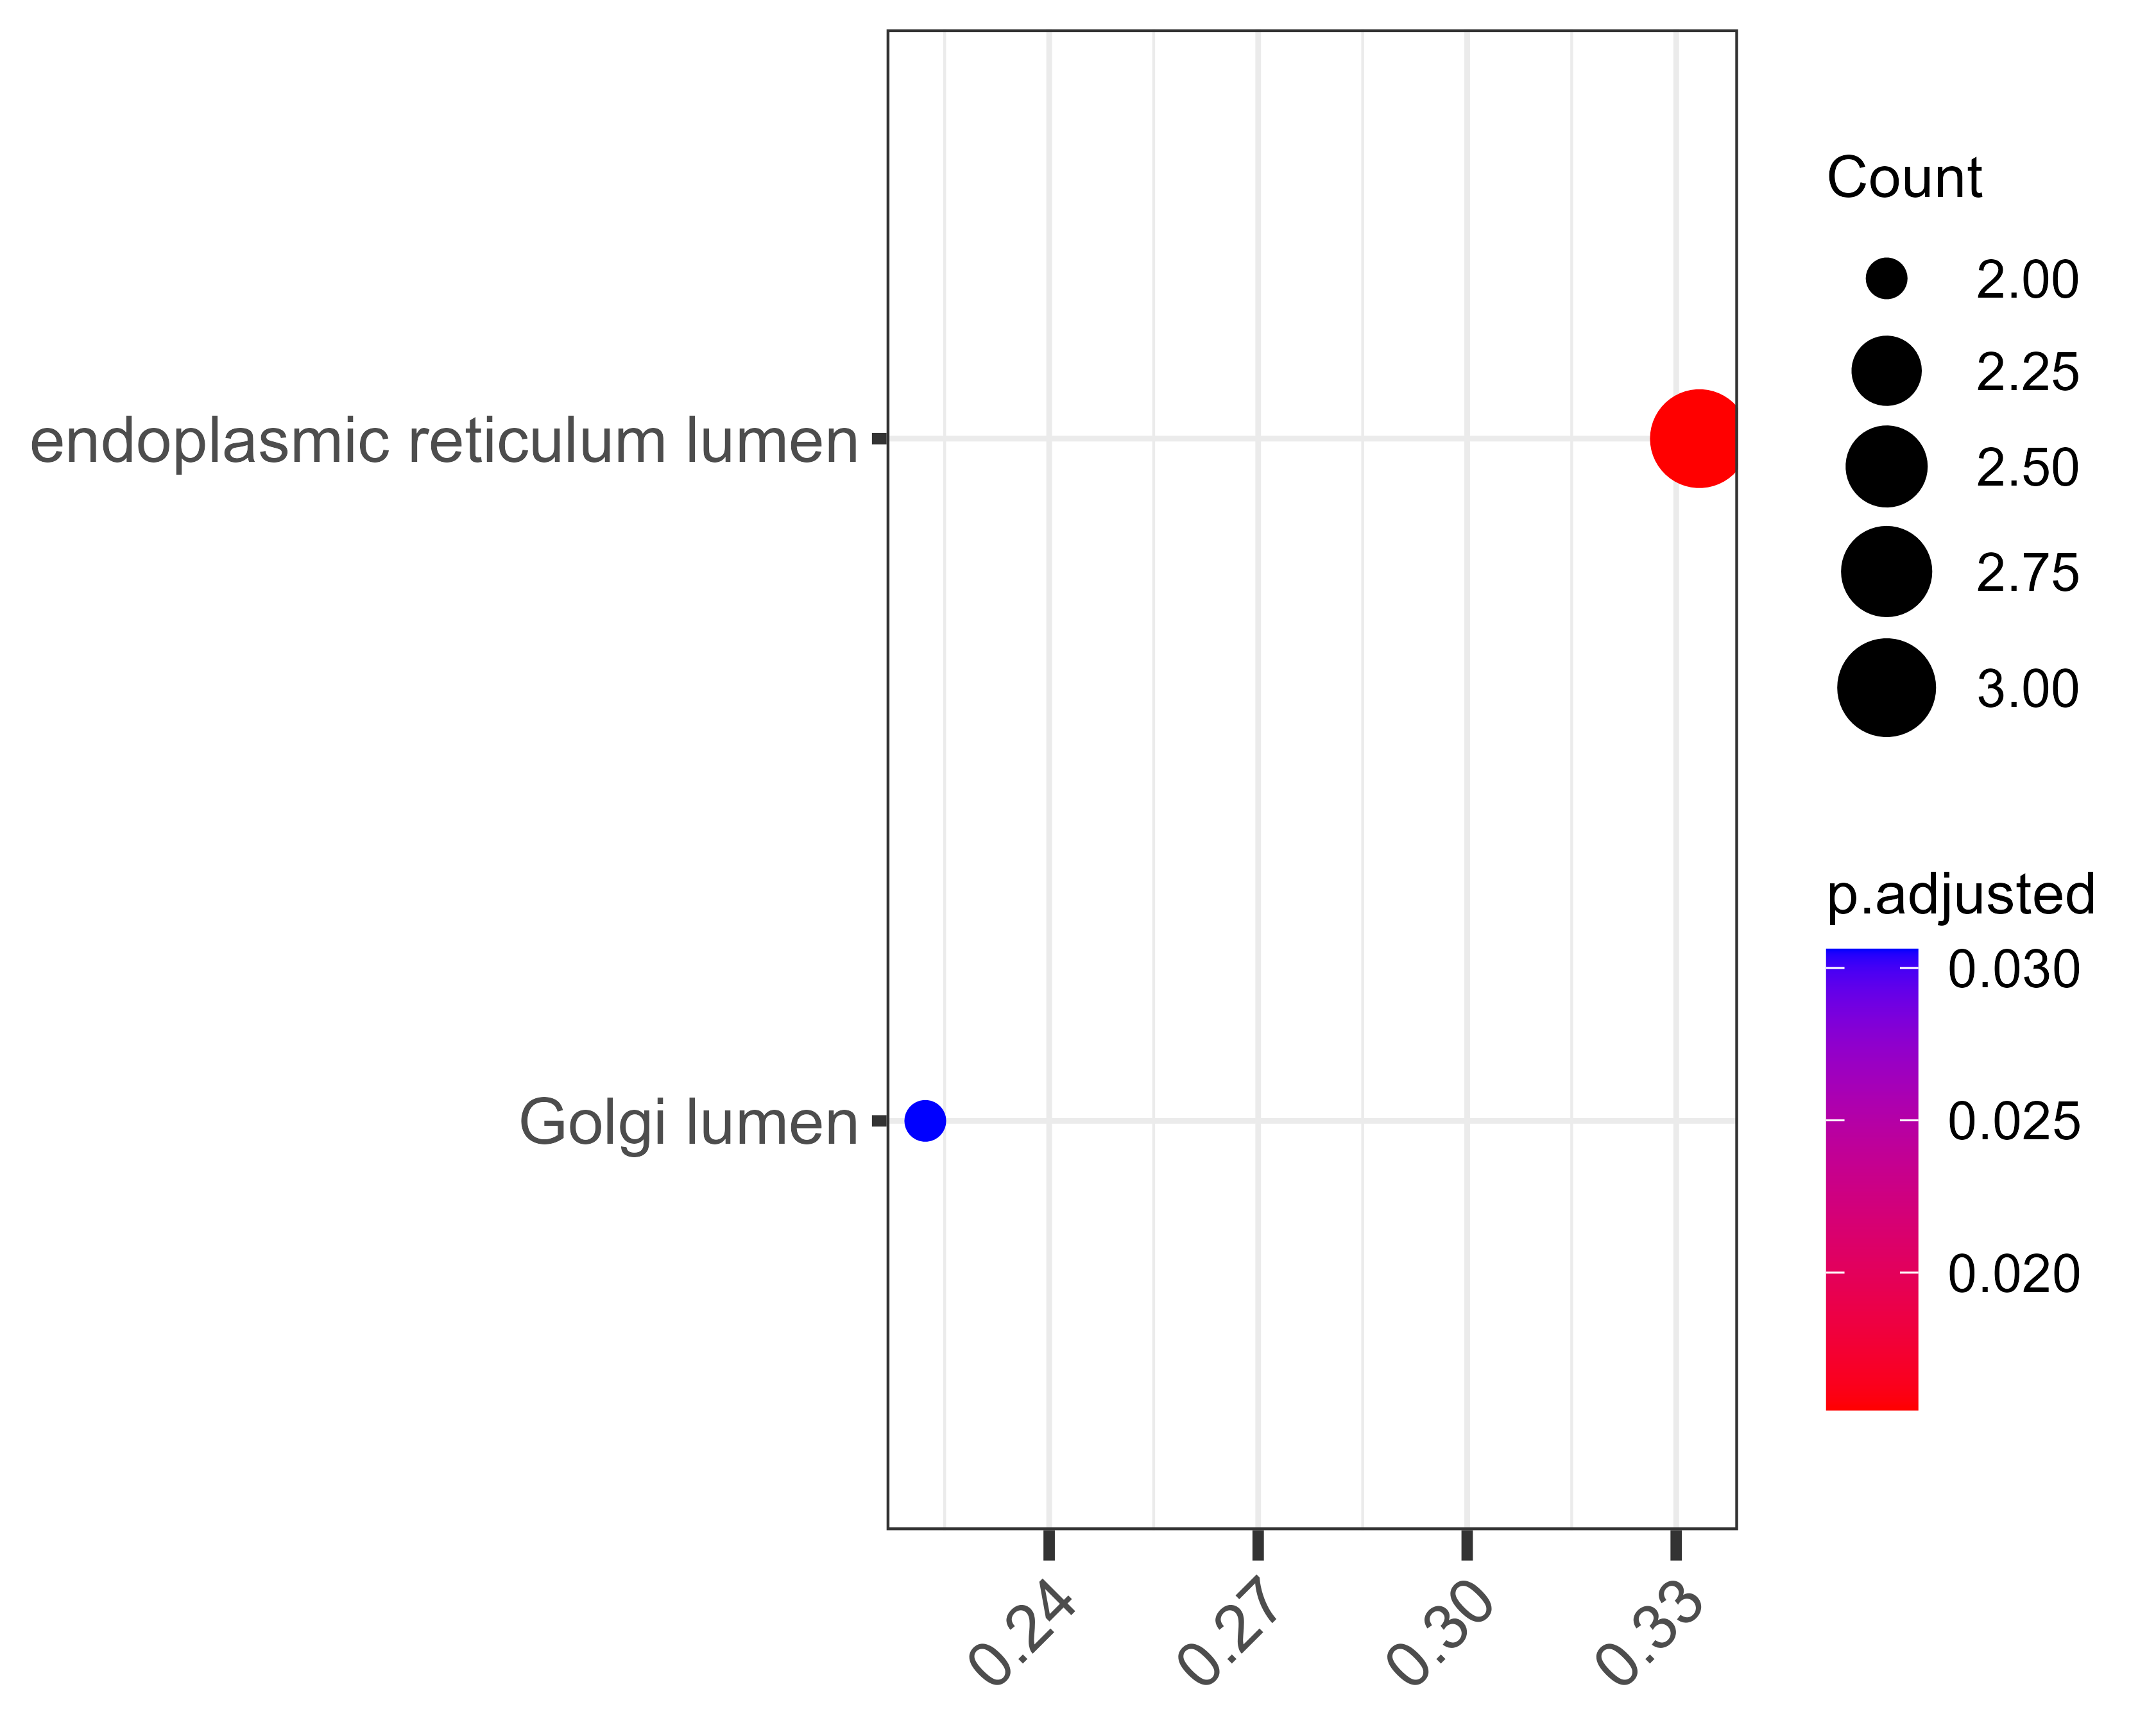
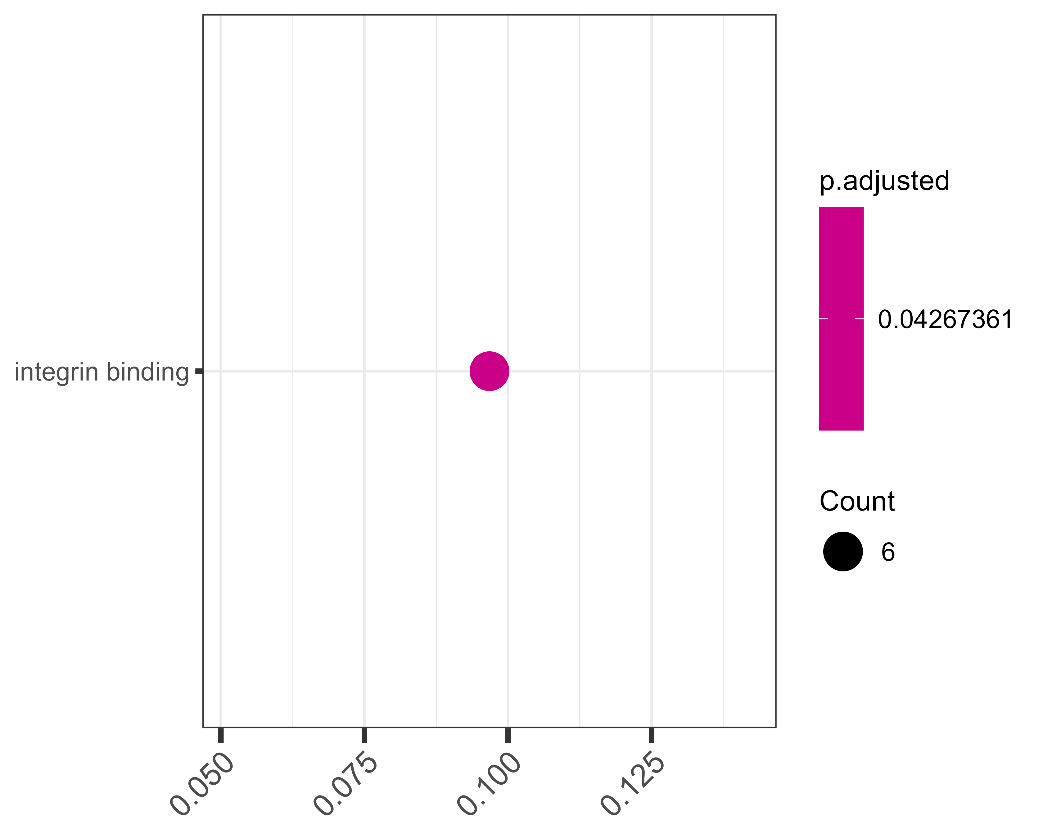
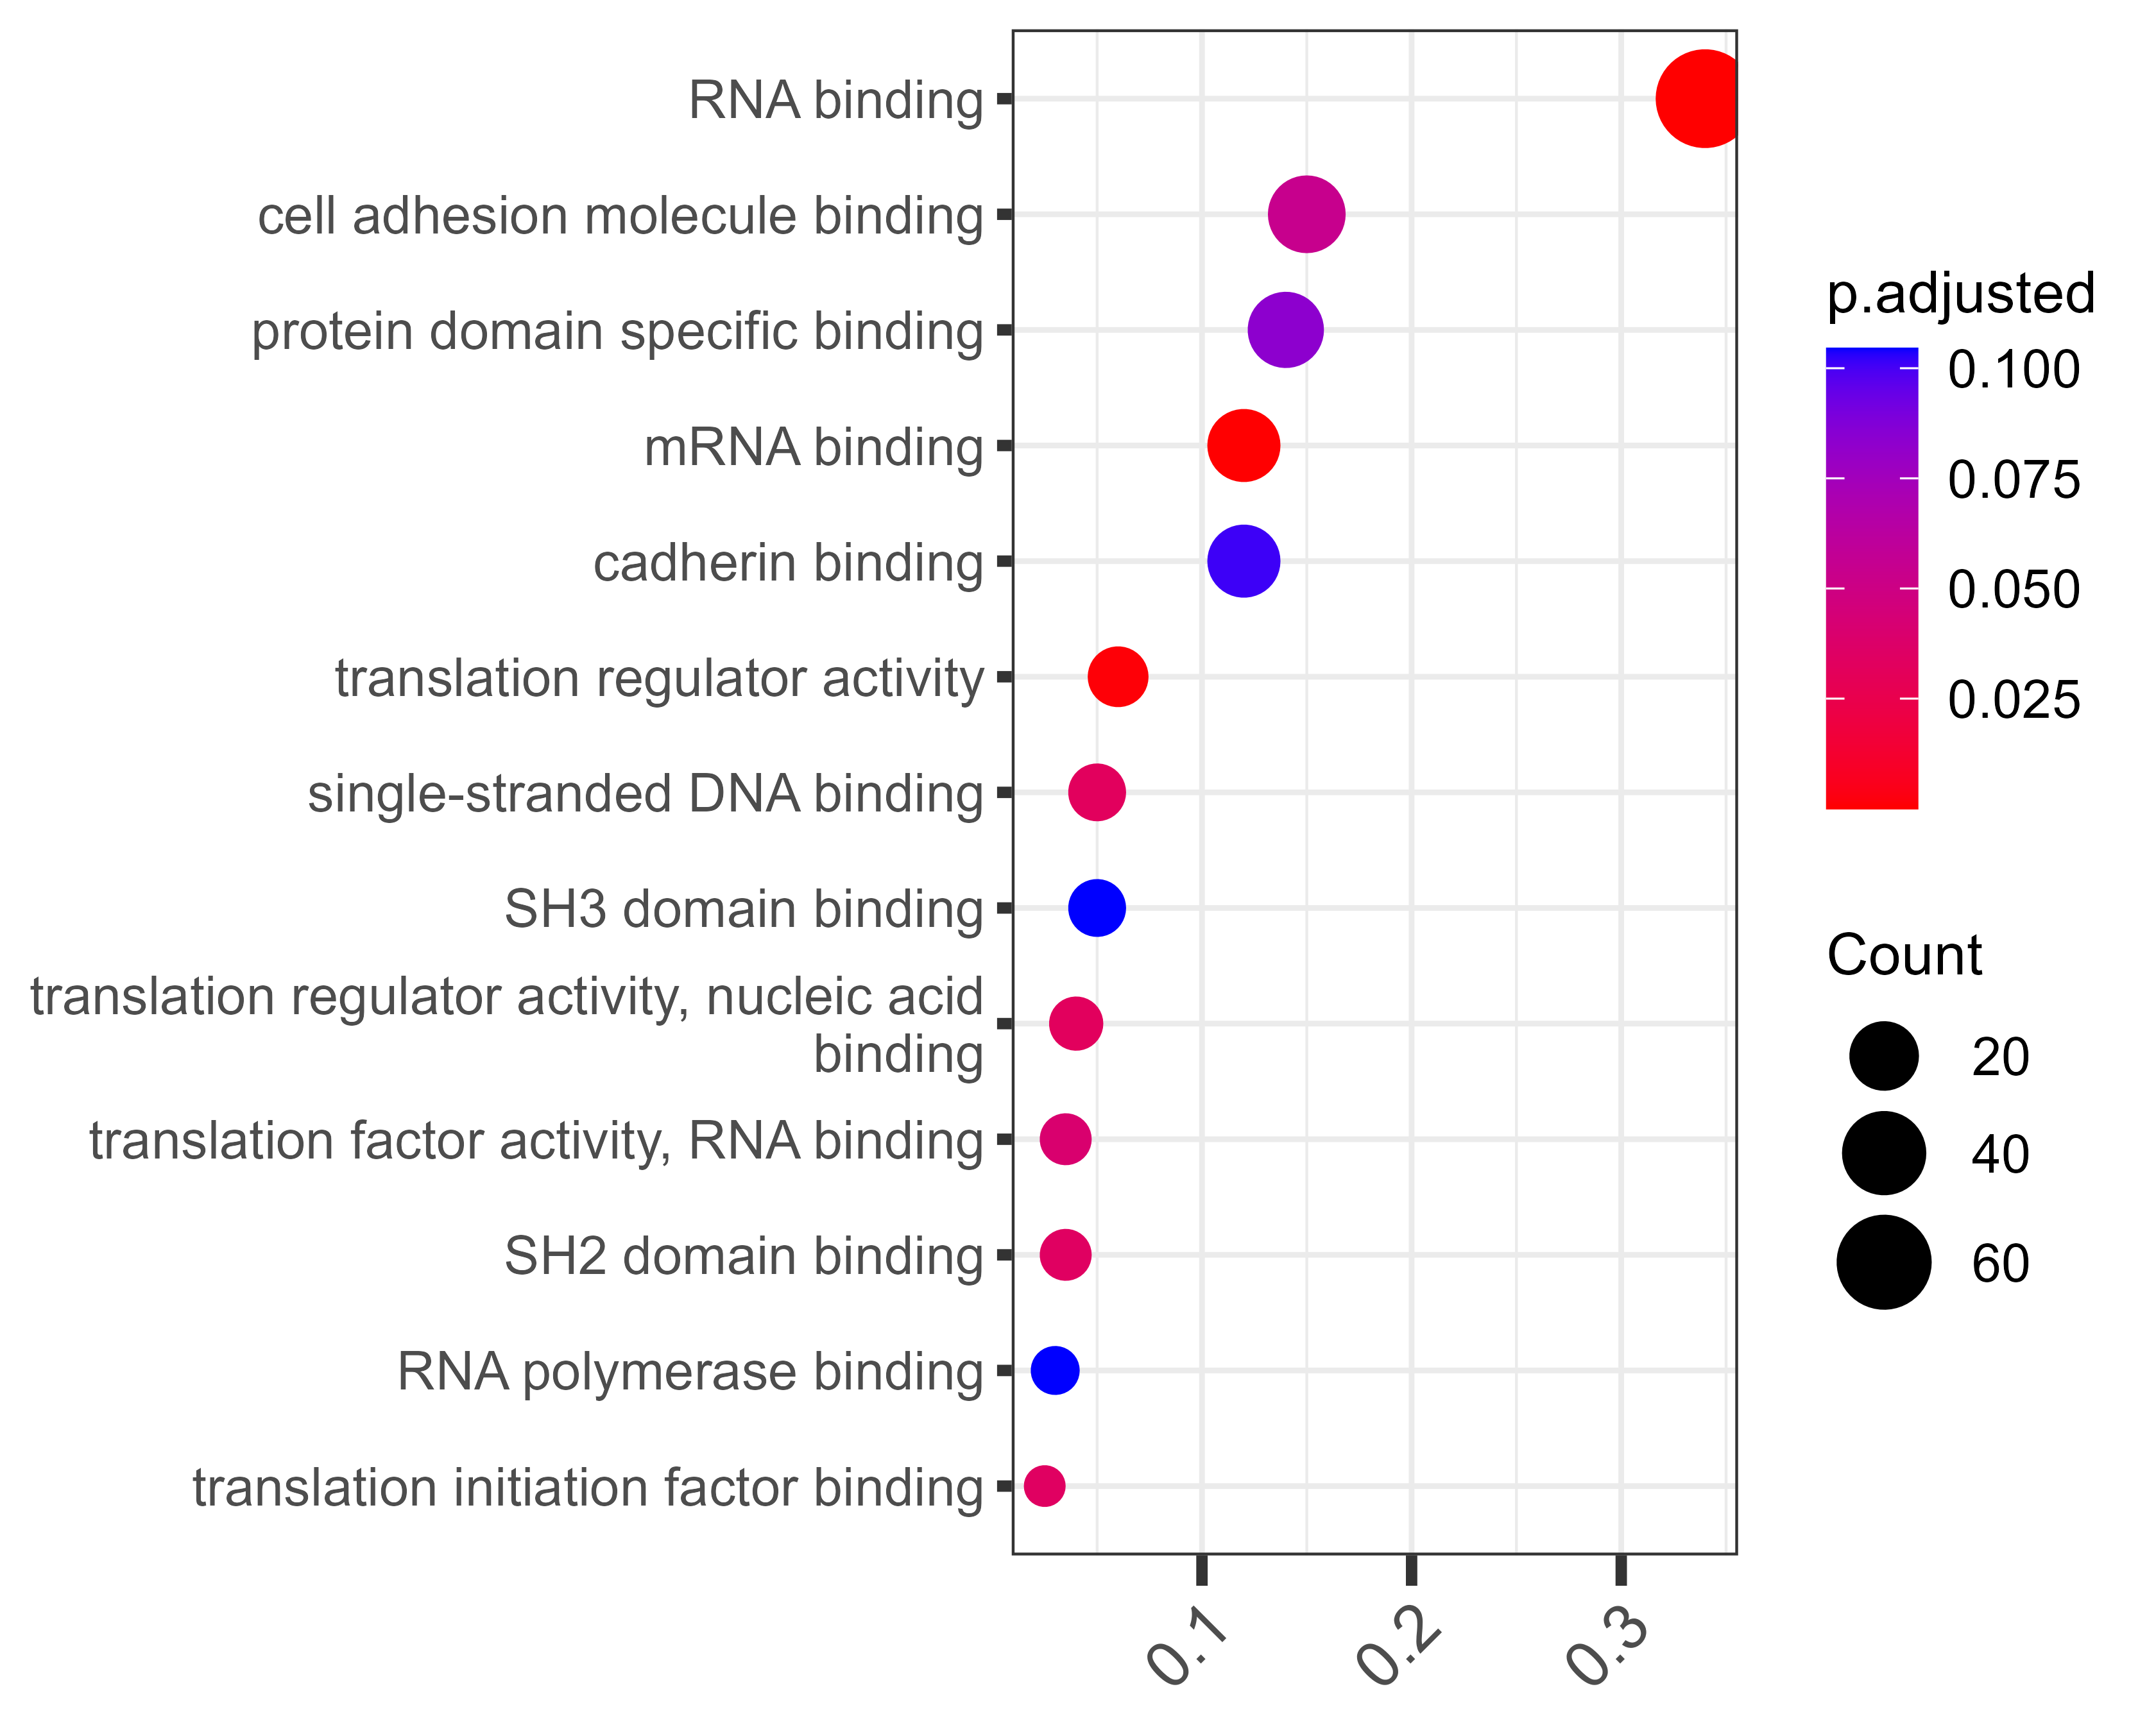
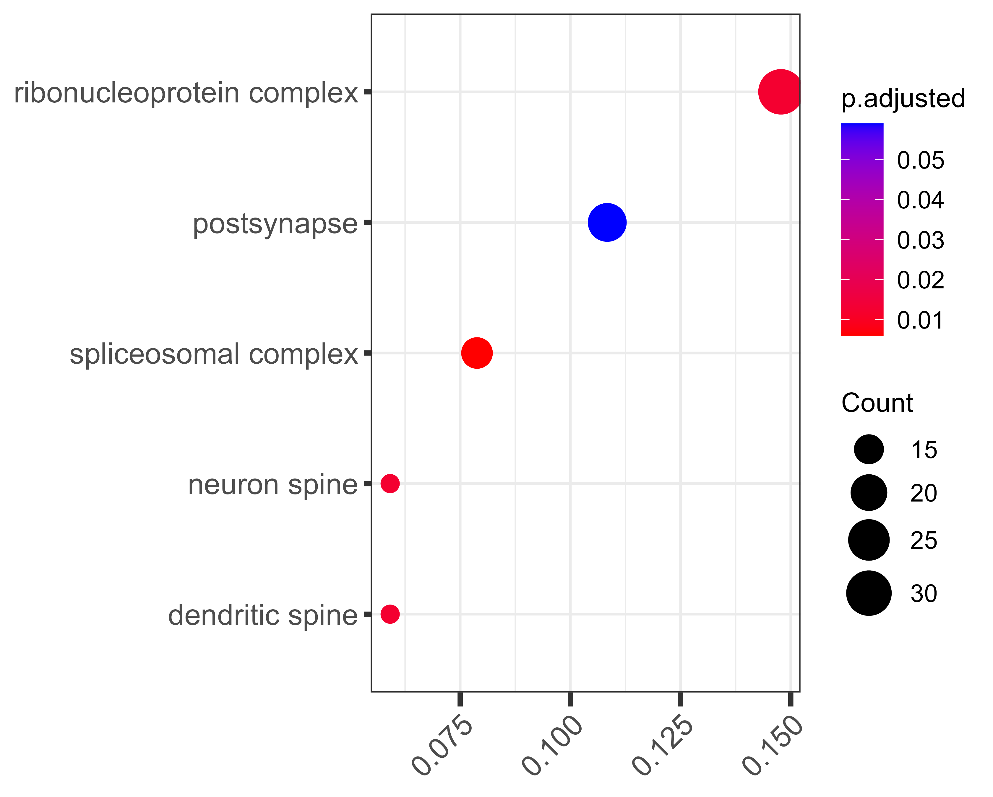
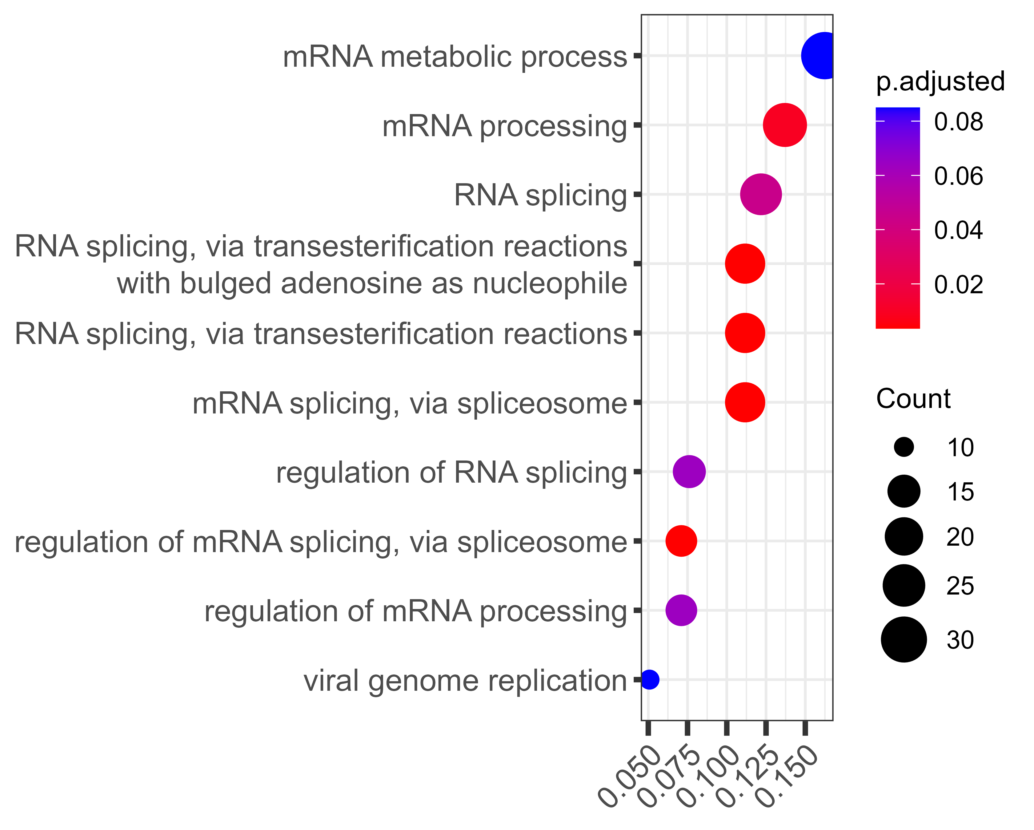
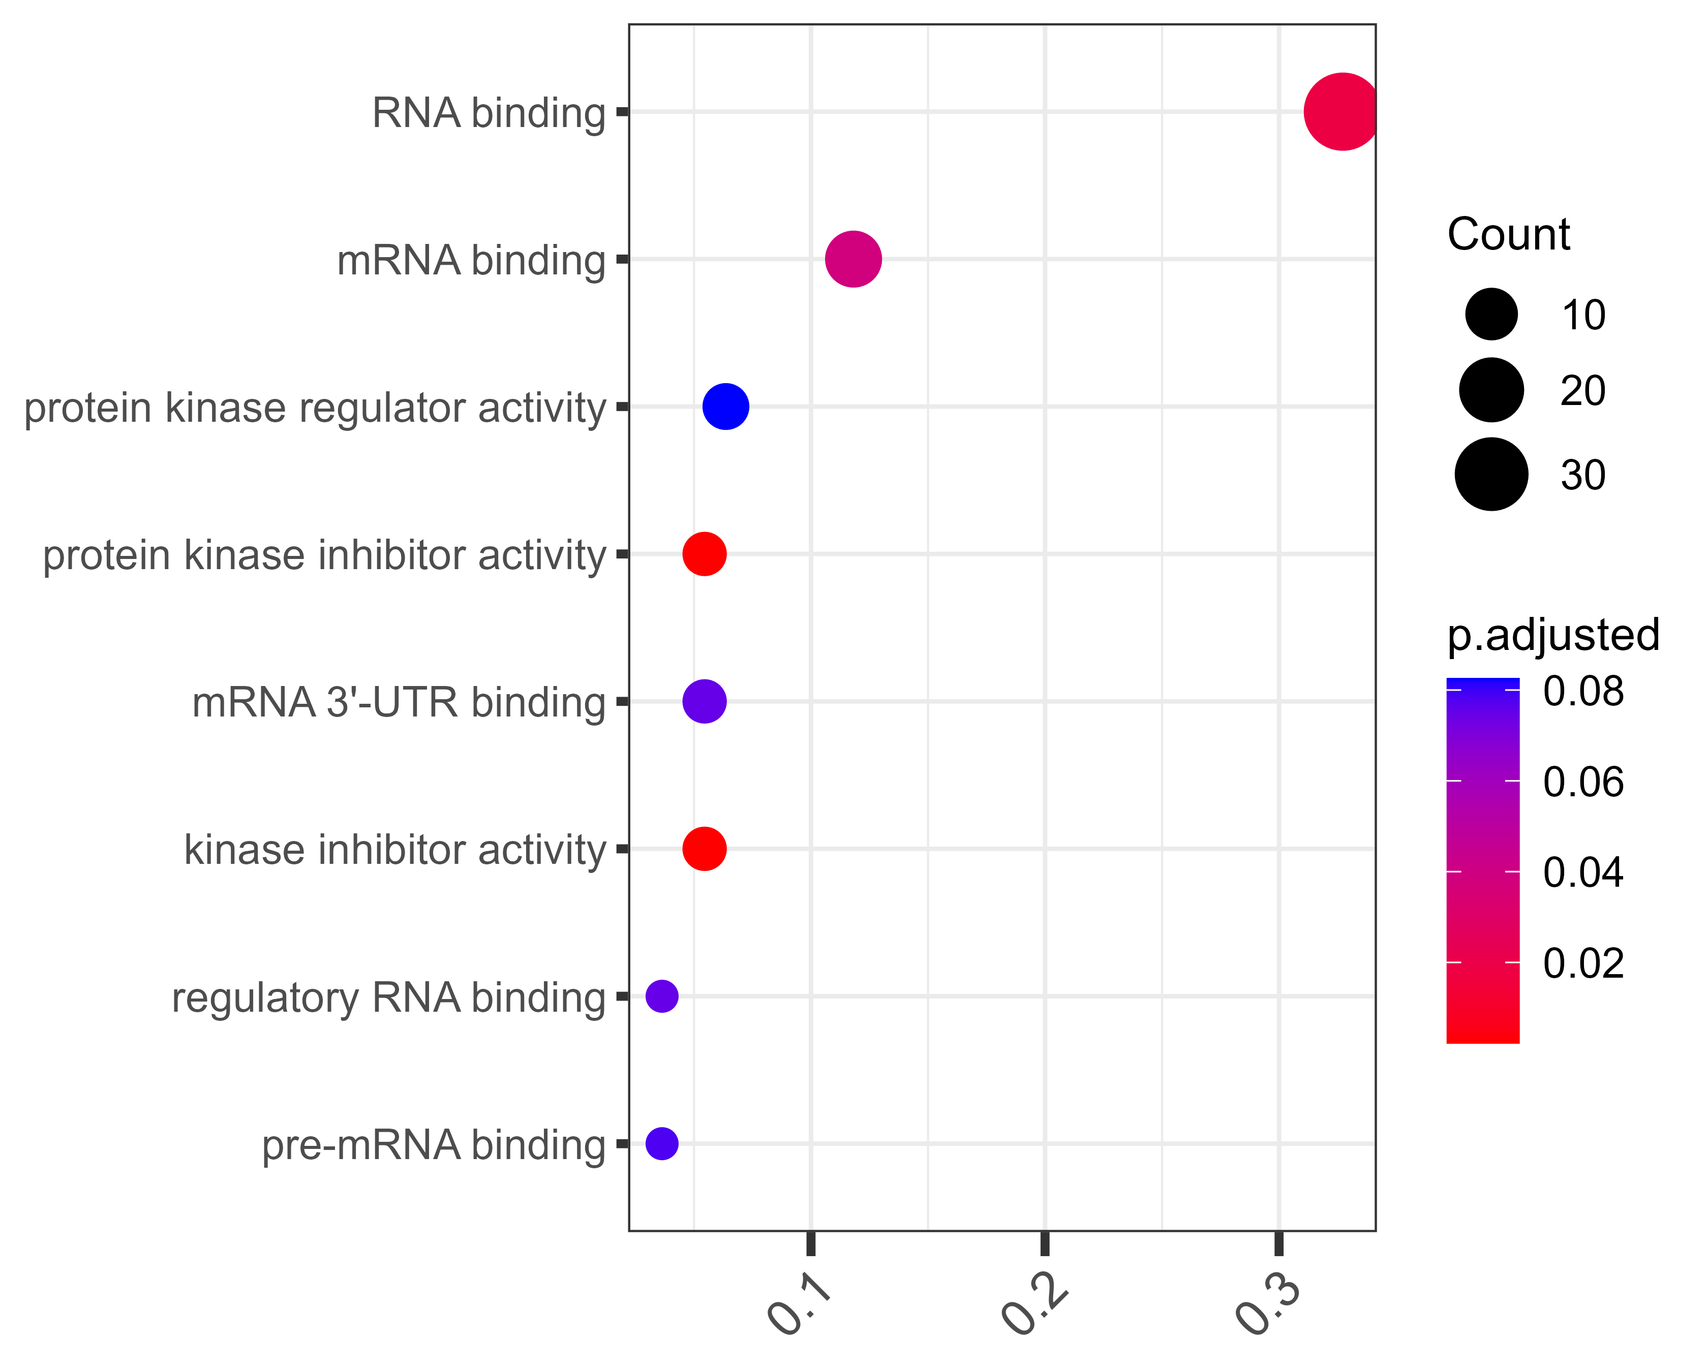
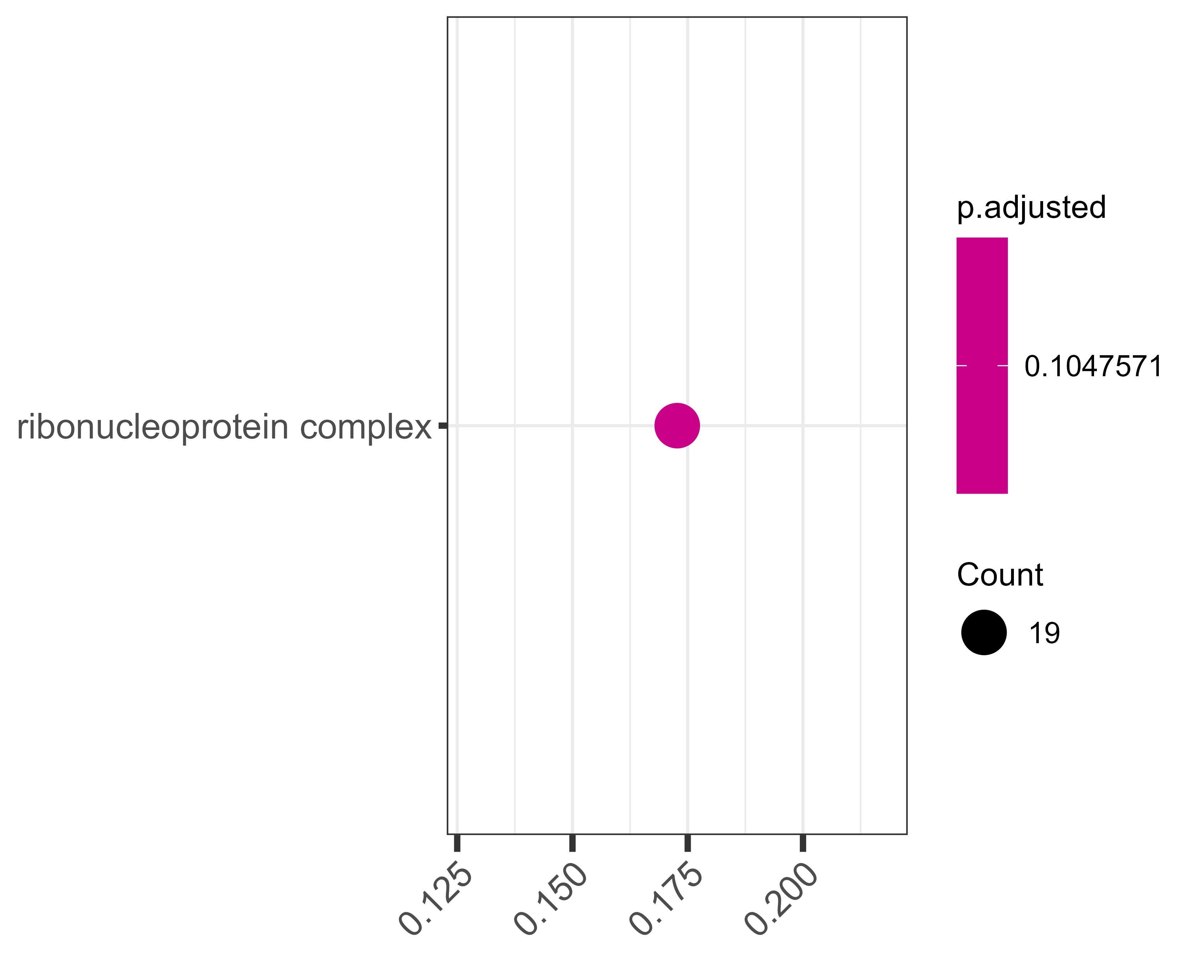
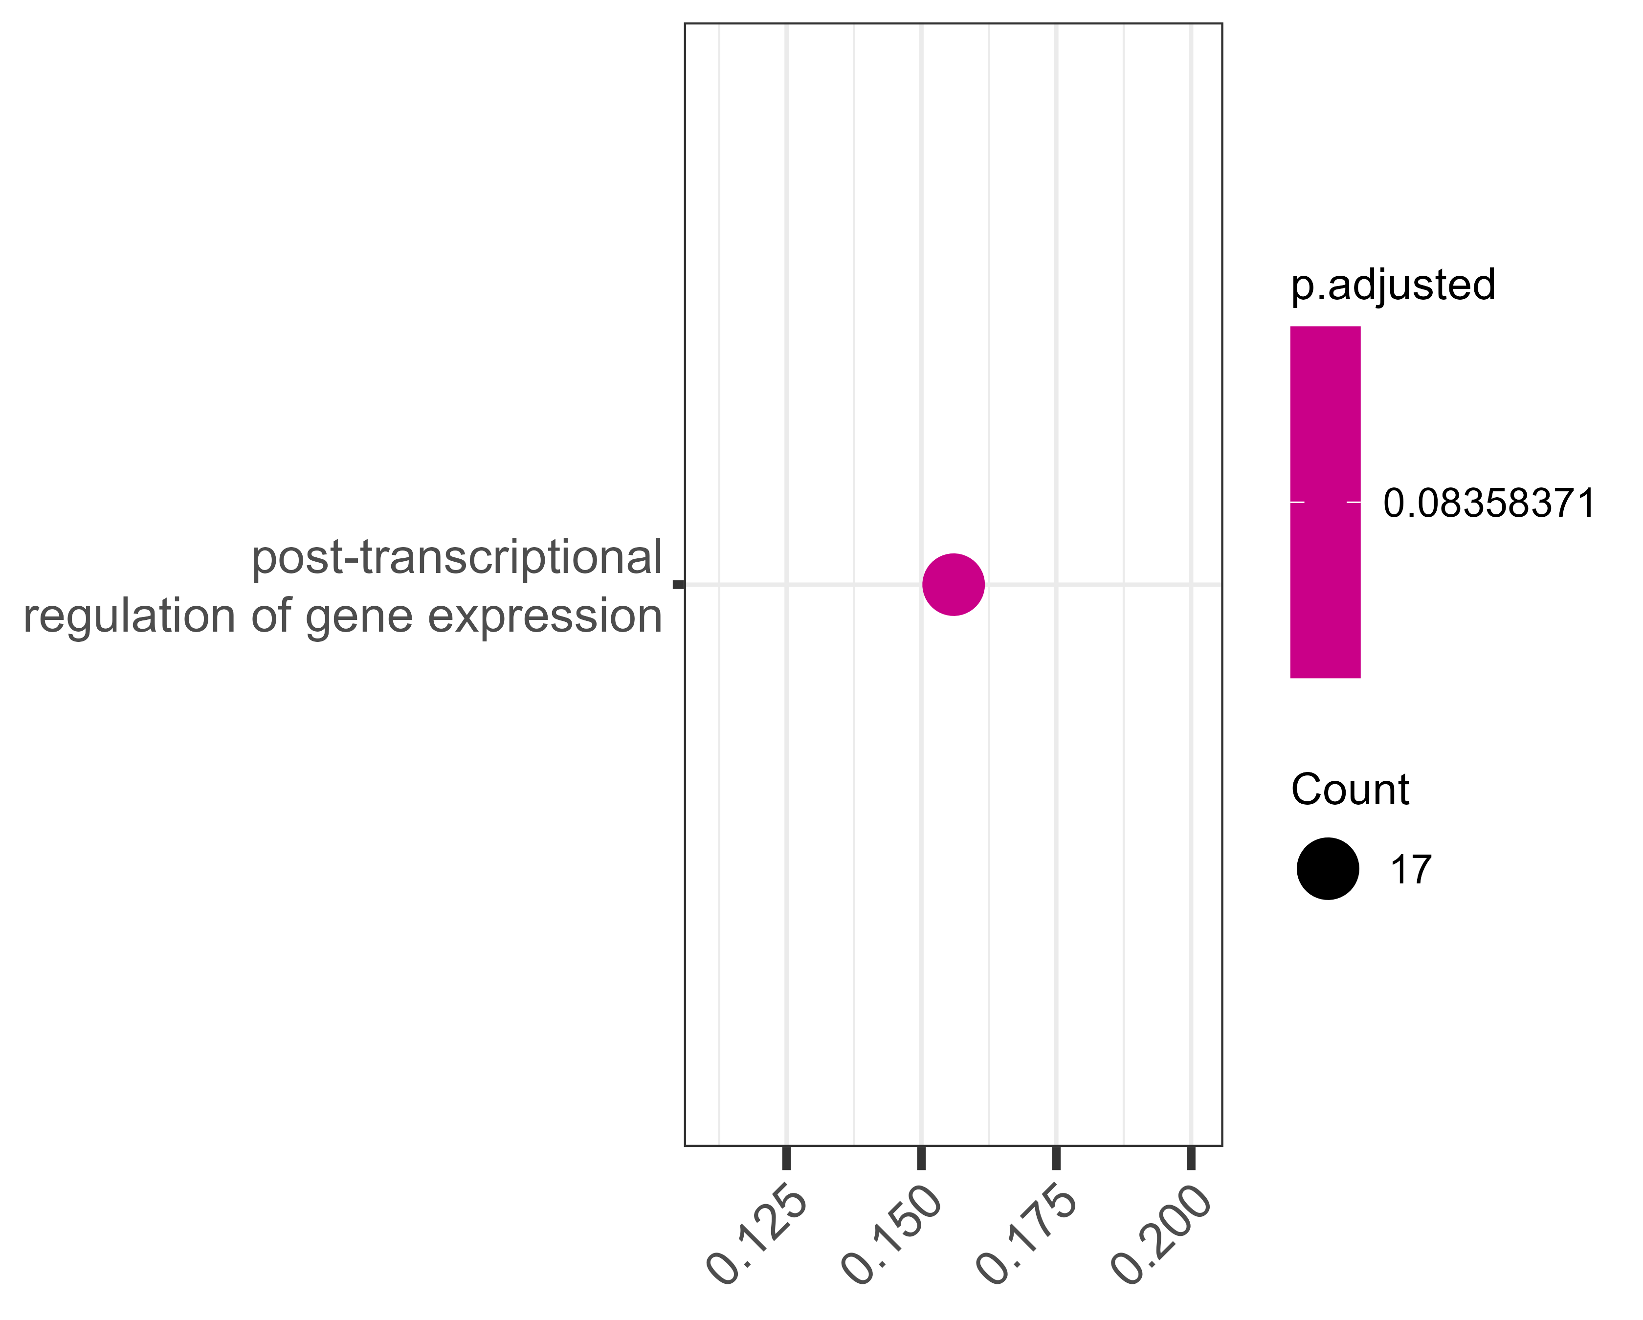
MF
CC
BP
No hits
with q <= 0.1
BOI-M1
No hits
with q <= 0.1
No hits
with q <= 0.1
BOI
DECOY1
No hits
with q <= 0.1
No hits
with q <= 0.1
No hits
with q <= 0.1
DECOY2
DECOY3
Conclude from here that custom terms may be more suitable as sY is not strictly associated with any particular BP/MF/CC?
NOTES – TO READ/DISCUSS
Notes:
NEED HELP MAKING CHOICE HERE – better way to visualise these?
Cytokines known to be sulfated -
TODO: change plot margins individually so all terms fit; do we even want to do q 0.1 just to show some of the close to significant hits?
I think these are interesting to show for the DECOY bins especially since we have large enough counts in the significant terms. This can tie in with later on results showing specific instruments seem to contribute to these bins more – next thing to consider here is if it is the instrument or the specific tissue/conditions studied and if it’s more prone to changes in these significant processes/functions?
OR is there some other bias in the enrichment terms themselves and the current ways in which we do such analyses?

Slide 8
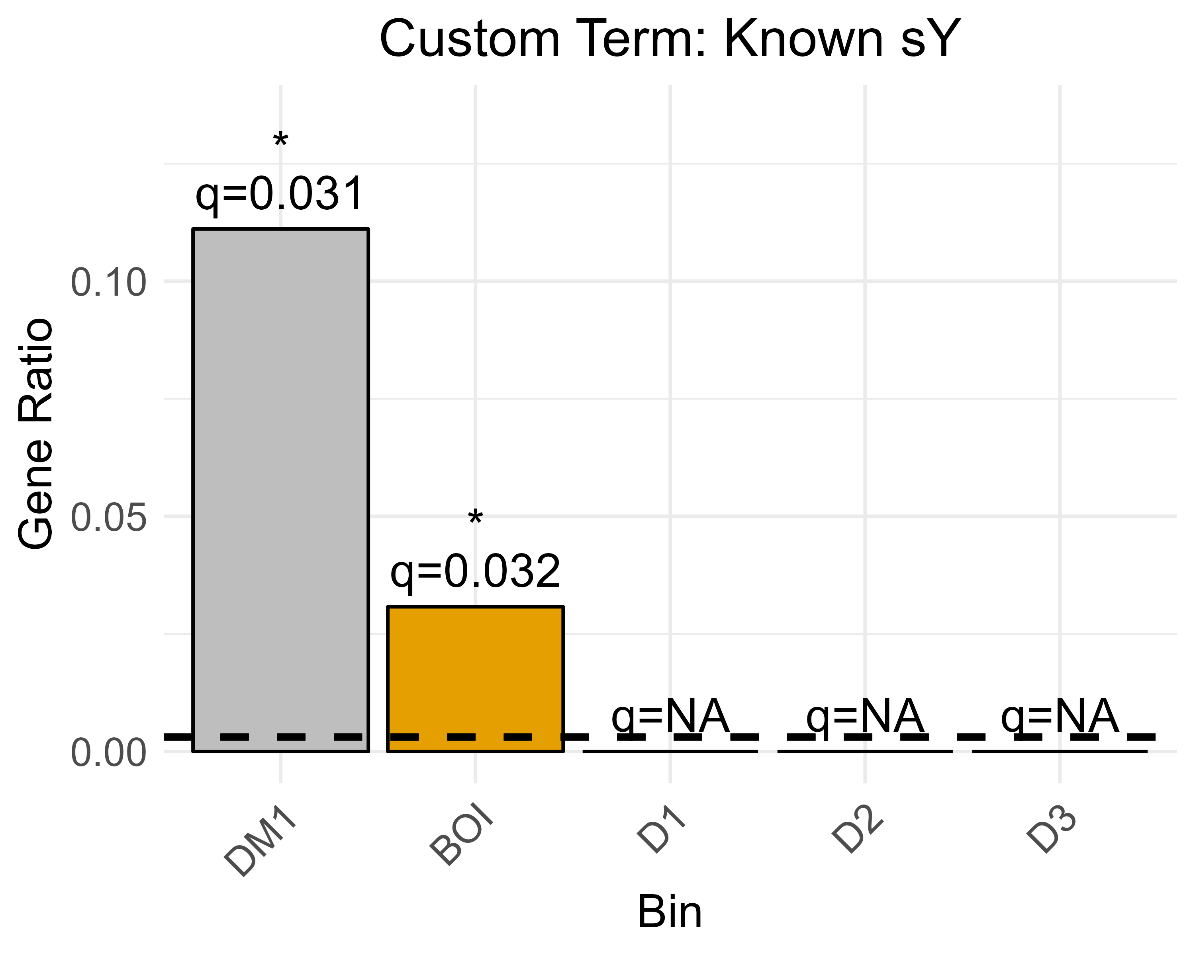
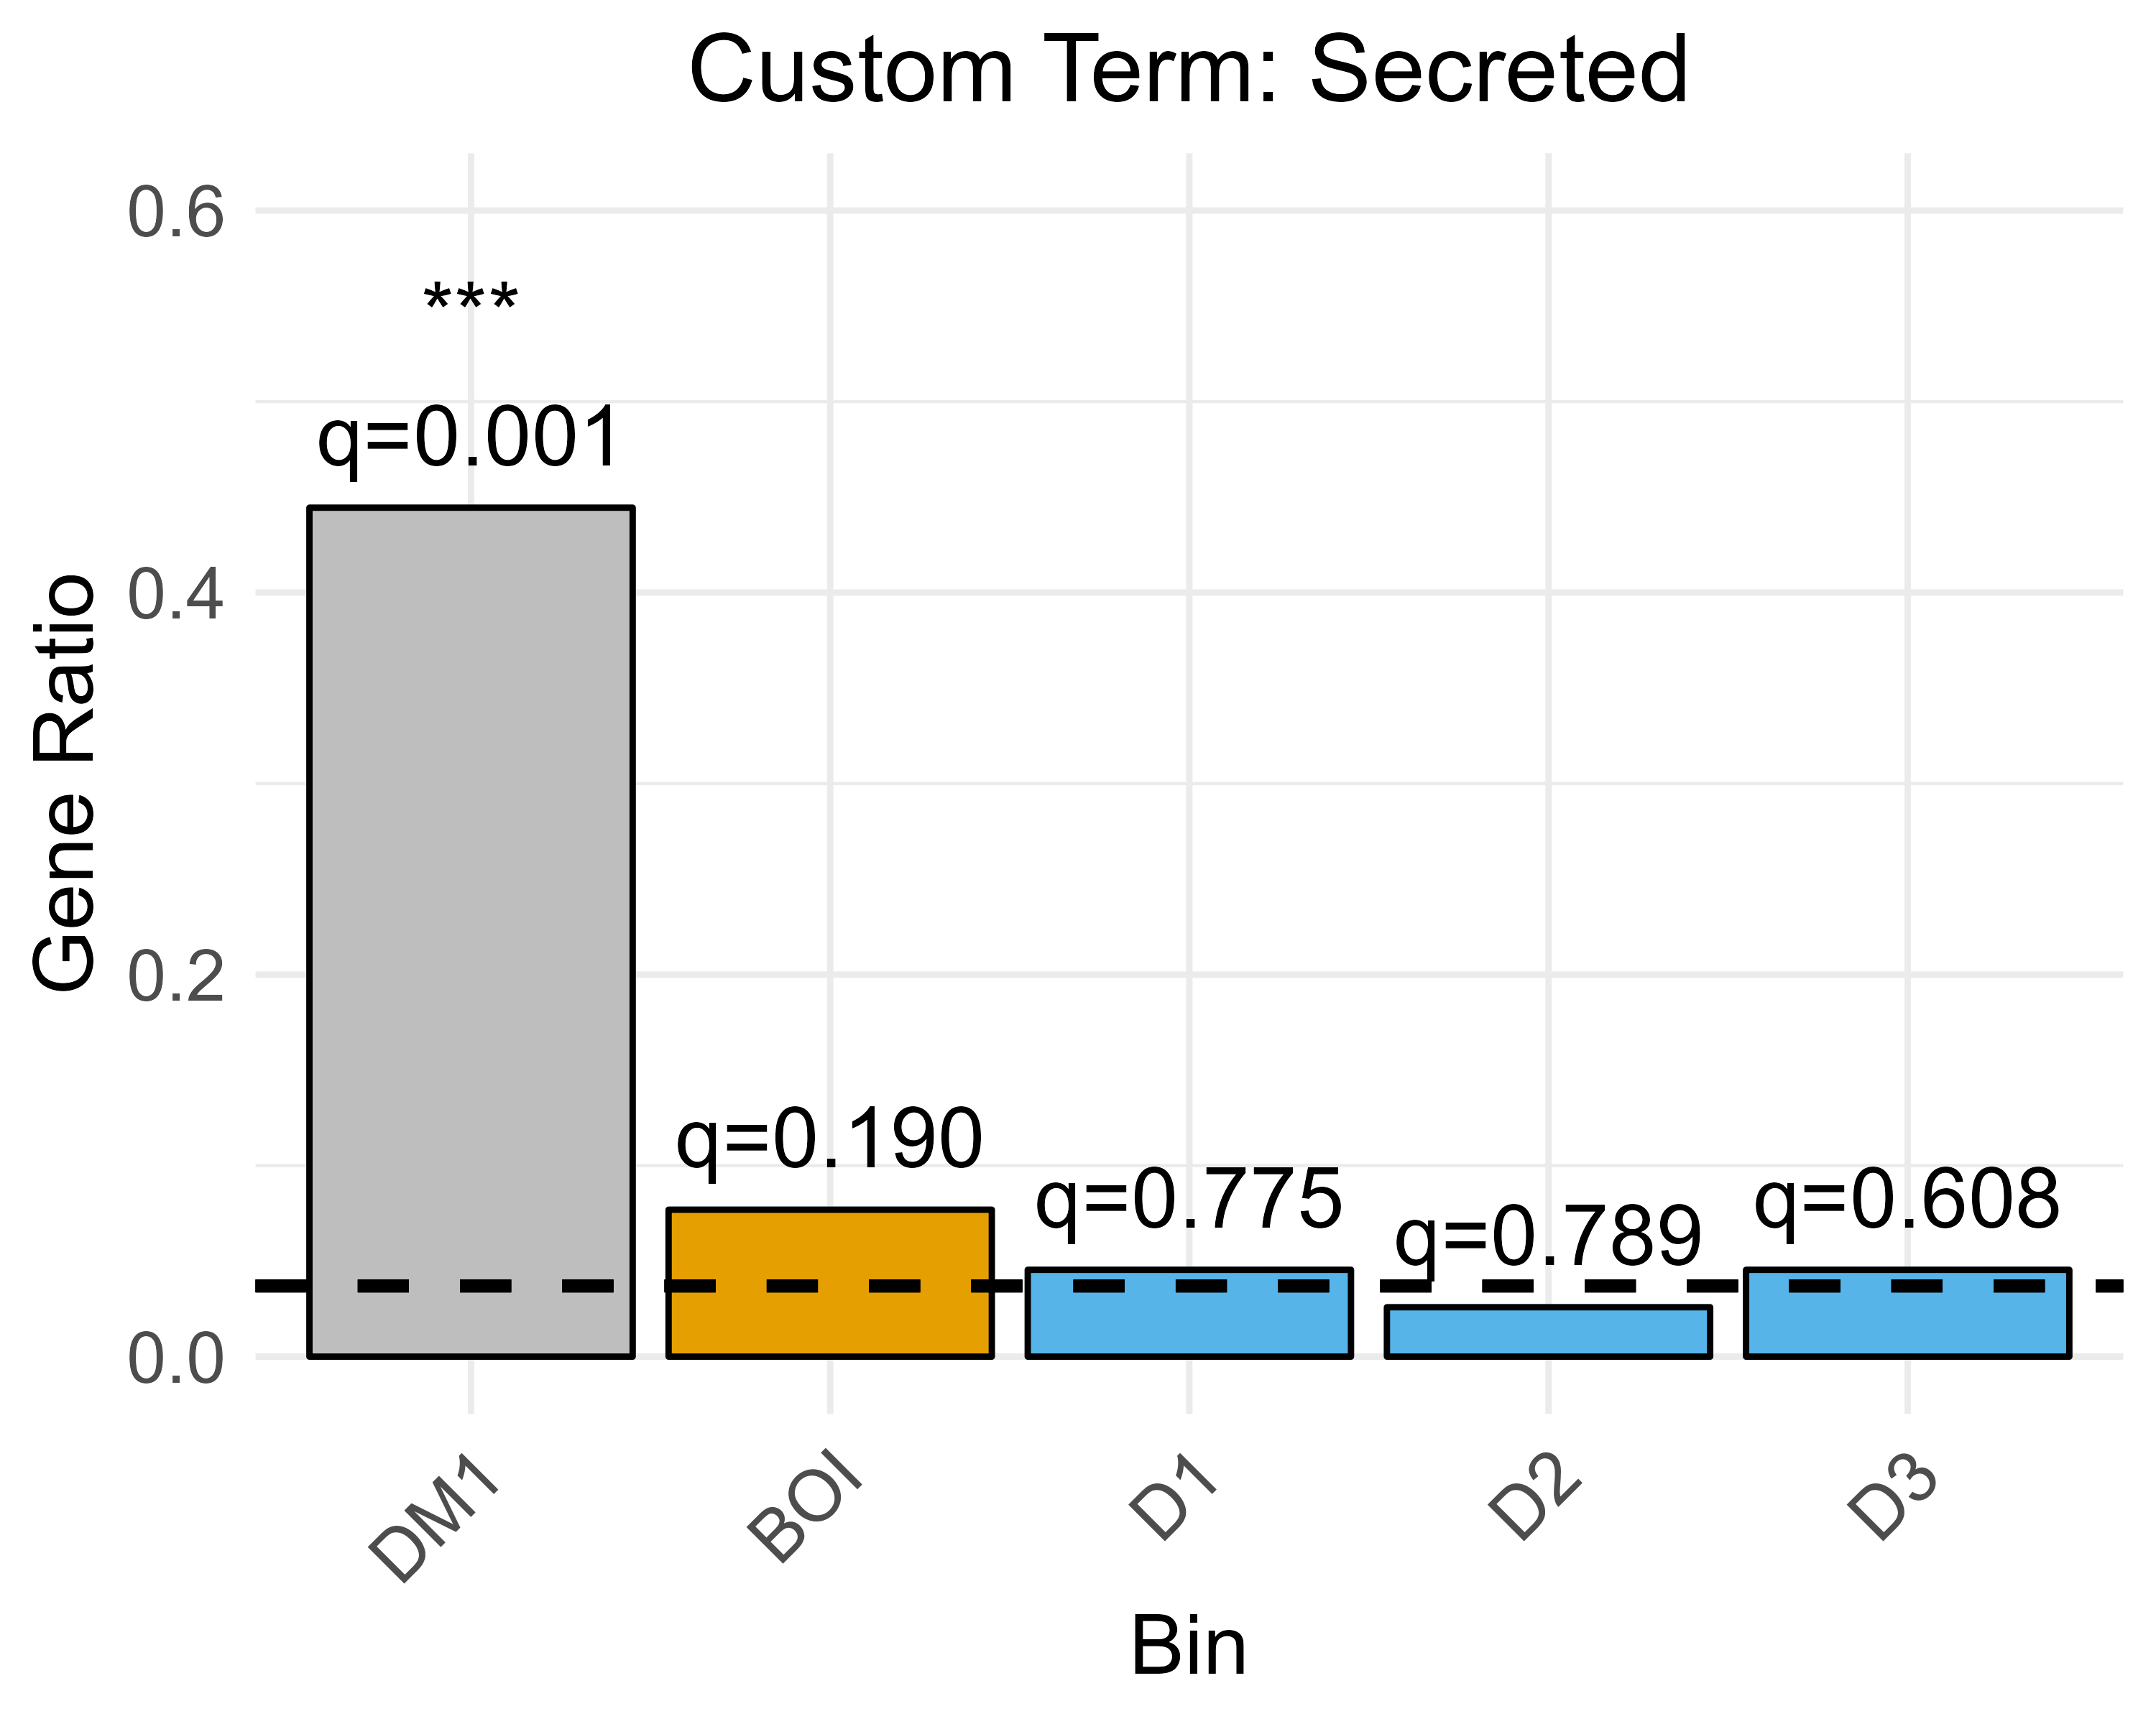
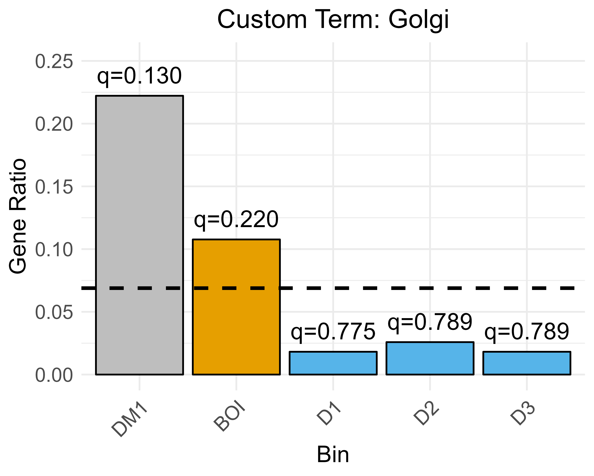
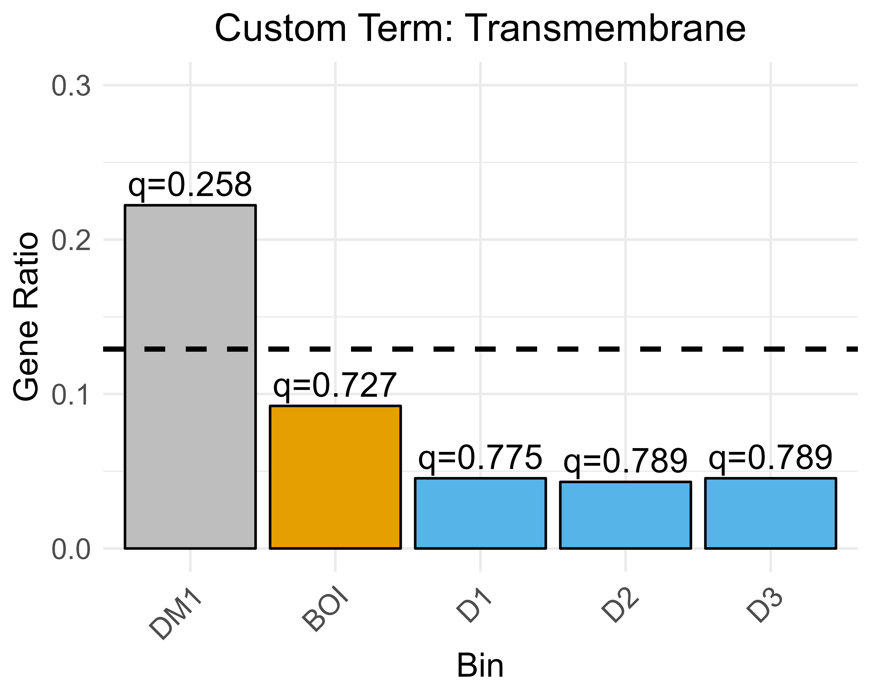
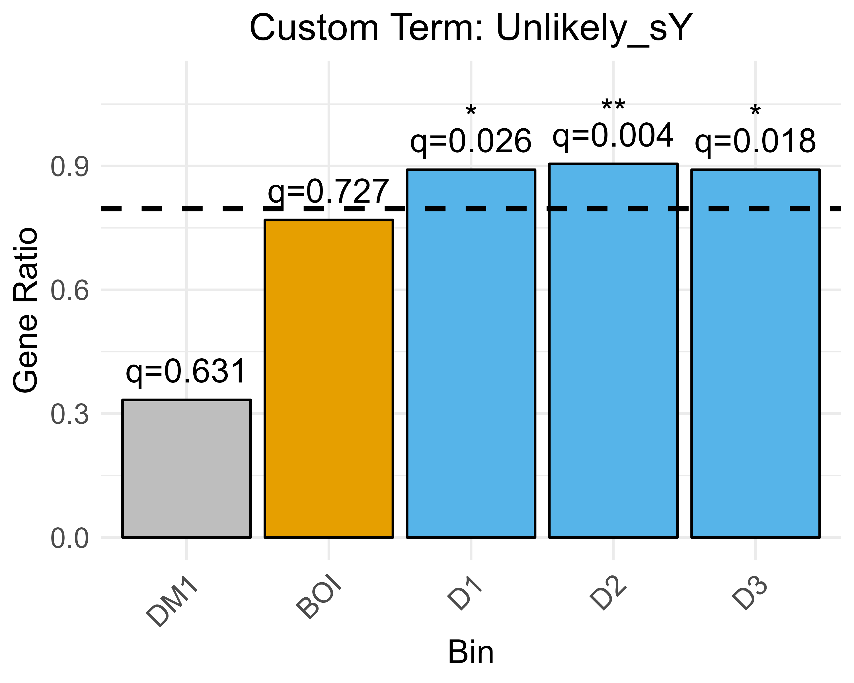
A
B
C
D
E
Fig. 4. Custom Terms overrepresentation enrichment analyses bin of interest vs DECOY bins
Can find known, we’ve been conservative but it’s possible to find a signal; it’s not a massive confusing factor
Make sure to mention actual number of genes in text in the context of number of peptides and number of peptidoforms too.
What about the other 4 known sY that we are detecting? How do their histograms look like?
Are they sulfated portions of the peptide at all?

Slide 9
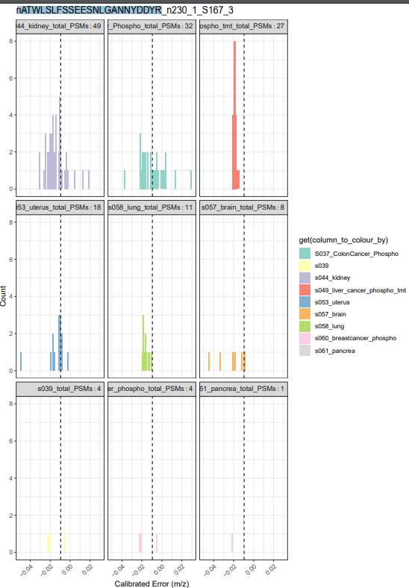
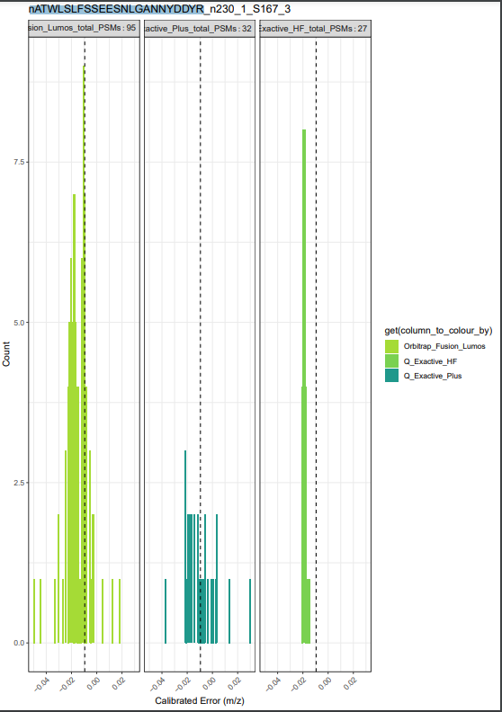
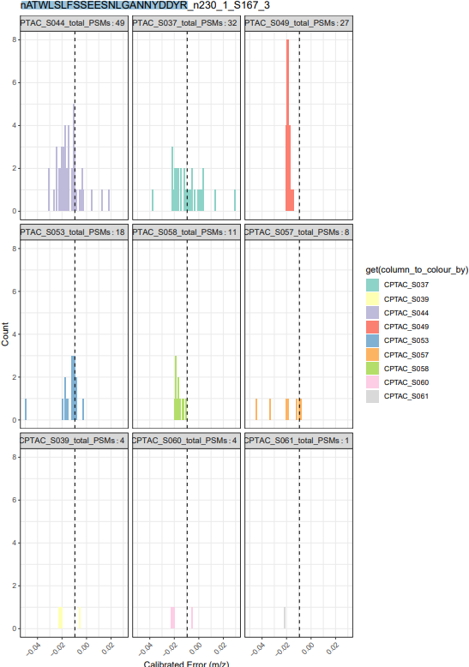
EXAMPLE PLOTS – can add as supplementary

Slide 10
A
B
C
D
E
Fig. 5. Final figure - digging deeper into USIs of specific peptidoform IDs – top 3 PSMs
TO DO:
Two-way ANOVA
Dependent continuous variable - number of PSMs contributed by an instrument or a category of instruments is the
Independent variable 1 – the instrument (or instrument sensitivity)
Option 1
Independent variable 2 – the “group” – e.g. peptidoforms that are in BOI that are likely sY based on their spectrum and protein assignment VS peptidoforms that are false positives in BOI
Option 2
Independent variable 2 – BOI vs all other PSMs (more conmputationally difficult and time consuming)
e.g. peptidoform is “rep”;

Slide 11
 | Custom_Tag | sY | Golgi | Secreted | Transmembrane | Unlikely
 | BgRatio | 6/2758 | 190/2758 | 102/2758 | 356/2758 | 2197/2758
DM1 | GeneRatio | 1/9 | 2/9 | 4/9 | 2/9 | 3/9
 | qvalue | 0.031 | 0.130 | 0.001 | 0.258 | 0.631
BOI | GeneRatio | 2/65 | 7/65 | 5/65 | 6/65 | 50/65
 | qvalue | 0.032 | 0.220 | 0.190 | 0.727 | 0.727
D1 | GeneRatio | 0/209 | 8/209 | 5/209 | 21/209 | 180/209
 | qvalue | NA | 0.775 | 0.775 | 0.775 | 0.026
D2 | GeneRatio | 0 | 3/116 | 3/116 | 5/116 | 105/116
 | qvalue | NA | 0.789 | 0.789 | 0.789 | 0.004
D3 | GeneRatio | 0 | 2/110 | 5/110 | 5/110 | 98/110
 | qvalue | NA | 0.789 | 0.608 | 0.789 | 0.018
ToDo – this table in its extended version should go in as a supplementary table (e.g. including p values, adj. p values, and genes);
Turn into a figure (similar to dotplot but instead a bar plot, showing max number of genes (in background) as colourless outline and number detected in as coloured portion + q value shown on top or something similar?
Fig. 4. Custom Terms enrichment analyses bin of interest vs DECOY bins
Can find known, we’ve been conservative but it’s possible to find a signal; it’s not a massive confusing factor
What about the other 4 known sY that we are detecting? How do their histograms look like?
Are they sulfated portions of the peptide at all?

Slide 12
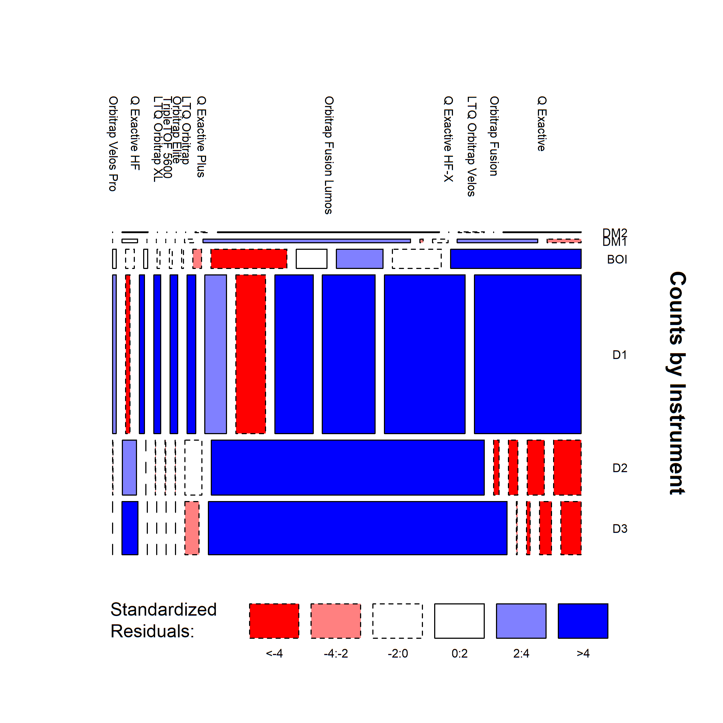
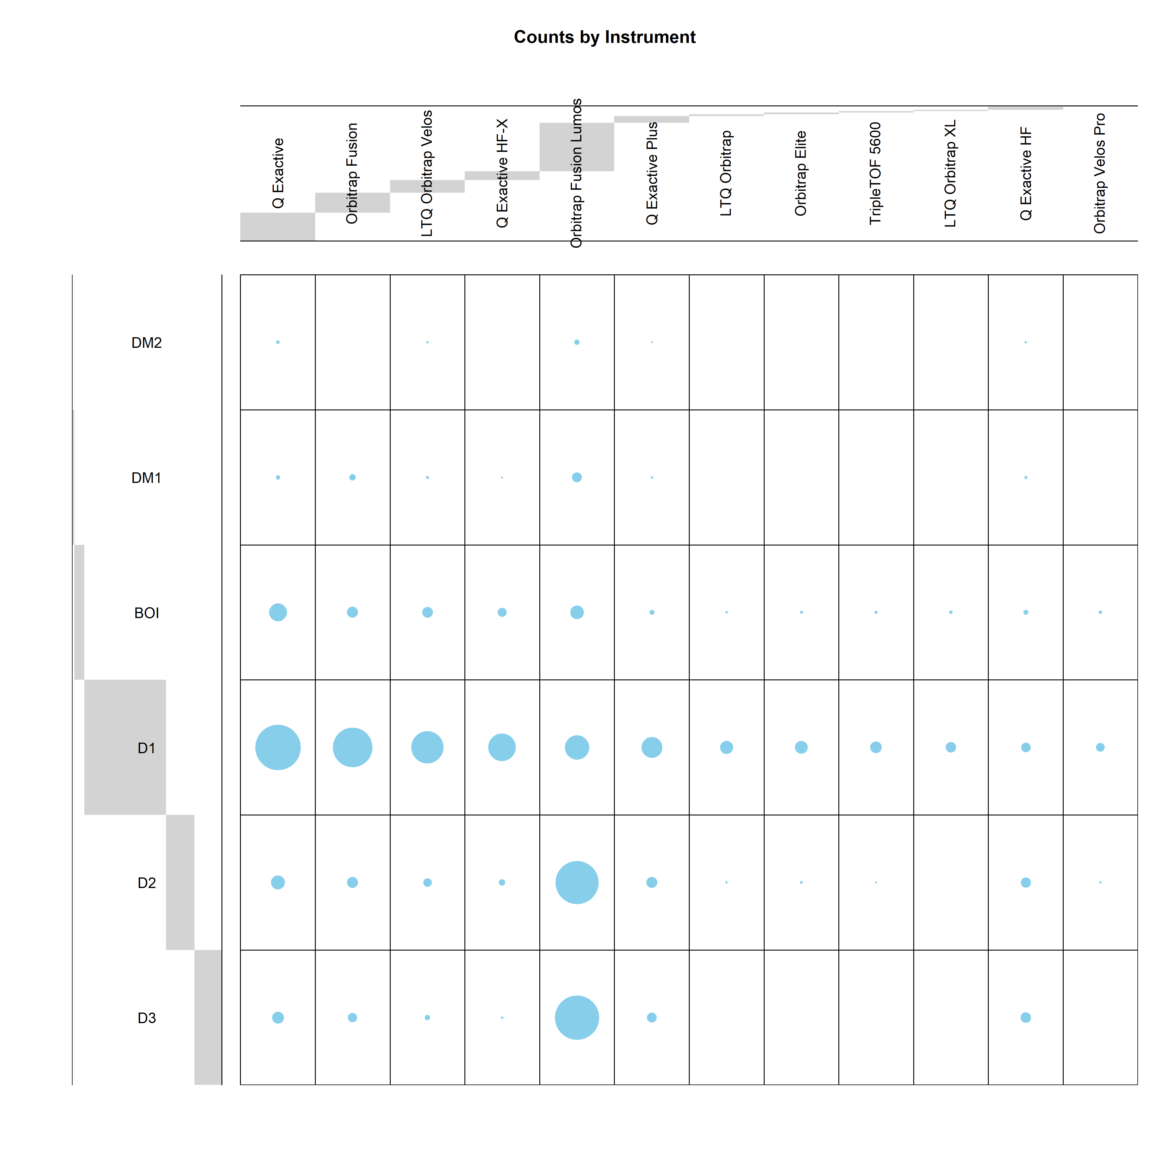
NB: Fusion Lumos seems to have some sort of bias to the + 0.01 hump?
Fig. 5. Instrument enrichment figures
ToDo – for peptidoforms in bin of interest make the colour coded barplots (e.g. overlay the current histograms we have with colour-coded scatterplot of experiment or instrument contribution to it.)
figure out how to change label angles and add some additional plots that will be interesting:
From original metadata – reduce down to only metadata for experiment tags we have received and plot:
Barplots :
# experimental tags/instrument
# datasets/instrument
# PSMs/instrument
Baloon/mosaic?
# number of tissue types / instrument?
Have done chi squared tests – do we want to include e.g. residual plots?
Notes:
This would be supplementary plots
To answer why not just use the best instruments?
Ones that are convincing and or known sY – do enrichment of instruments for that.

Slide 13
Next Steps
Finish visualisations agreed here
Further look into where our PSMs are coming from – any particular analysis/visualisation/corrections we could/should do
Write-up Results
Anything else?
List datasets rather than submitting to PRIDE?
List source PXDs, point to peptide atlas build.
Universal spectra identifier (google, then look at examples) (add to our PSMs) – PSM ids from bins of interest for the BEST 3 PSMs (closest to -0.09512?)
Row details – format these, get to Andy for help with peptidoform.
Equal prio as finishing results.
Promote this via the paper.
Hypothesis – confident ones there should be no ions that suggest phosphotyrosine (also no sulfo cause of neutral loss)

